Slide 1
SUPERVISED LEARNING LINEAR REGRESSION

Slide 2
What is Supervised Machine Learning?
Supervised Machine Learning is a Sub Category of Machine Learning and Artificial Intelligence. It is defined by its use of Labeled datasets to train algorithms that to classify data or predict outcomes acuurately.
In supervised learning, the training data provided to the machines work as the supervisor that teaches the machines to predict the output correctly. It applies the same concept as a student learns in the supervision of the teacher
Supervised learning is a process of providing input data as well as correct output data to the machine learning model. The aim of a supervised learning algorithm is to find a mapping function to map the input variable(x) with the output variable(y).
In the real-world, supervised learning can be used for Risk Assessment, Image classification, Fraud Detection, spam filtering, etc.

Slide 3
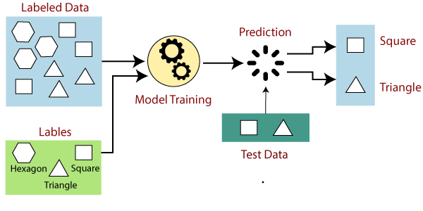
How Supervised Learning Works?
In supervised learning, models are trained using labelled dataset, where the model learns about each type of data. Once the training process is completed, the model is tested on the basis of test data (a subset of the training set), and then it predicts the output.
The working of Supervised learning can be easily understood by the below example and diagram:

Slide 4
Suppose we have a dataset of different types of shapes which includes square, rectangle, triangle, and Polygon. Now the first step is that we need to train the model for each shape.
If the given shape has four sides, and all the sides are equal, then it will be labelled as a Square.
If the given shape has three sides, then it will be labelled as a triangle.
If the given shape has six equal sides then it will be labelled as hexagon.
Now, after training, we test our model using the test set, and the task of the model is to identify the shape.
The machine is already trained on all types of shapes, and when it finds a new shape, it classifies the shape on the bases of a number of sides, and predicts the output.

Slide 5
Steps Involved in Supervised Learning:
First Determine the type of training dataset
Collect/Gather the labelled training data.
Split the training dataset into training dataset, test dataset, and validation dataset.
Determine the input features of the training dataset, which should have enough knowledge so that the model can accurately predict the output.
Determine the suitable algorithm for the model, such as support vector machine, decision tree, etc.
Execute the algorithm on the training dataset. Sometimes we need validation sets as the control parameters, which are the subset of training datasets.

Slide 6
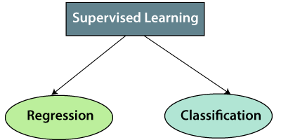
Types of supervised Machine learning Algorithms:
Supervised learning can be further divided into two types of problems:

Slide 7
Regression:
Regression algorithms are used if there is a relationship between the input variable and the output variable. It is used for the prediction of continuous variables, such as Weather forecasting, Market Trends, etc. Below are some popular Regression algorithms which come under supervised learning:
Linear Regression
Regression Trees
Non-Linear Regression
Bayesian Linear Regression
Polynomial Regression

Slide 8
2. Classification
Classification algorithms are used when the output variable is categorical, which means there are two classes such as Yes-No, Male-Female, True-false, etc.
Spam Filtering,
Random Forest
Decision Trees
Logistic Regression
Support vector Machines
Advantages of Supervised learning:
With the help of supervised learning, the model can predict the output on the basis of prior experiences.
In supervised learning, we can have an exact idea about the classes of objects.
Supervised learning model helps us to solve various real-world problems such as fraud detection, spam filtering, etc.

Slide 9
Disadvantages of supervised learning:
Supervised learning models are not suitable for handling the complex tasks.
Supervised learning cannot predict the correct output if the test data is different from the training dataset.
Training required lots of computation times.
In supervised learning, we need enough knowledge about the classes of object.

Slide 10
Simple Linear Regression in Machine Learning:
Simple Linear Regression is a type of Regression algorithms that models the relationship between a dependent variable and a single independent variable. The relationship shown by a Simple Linear Regression model is linear or a sloped straight line, hence it is called Simple Linear Regression.
The key point in Simple Linear Regression is that the dependent variable must be a continuous/real value. However, the independent variable can be measured on continuous or categorical values.
Simple Linear regression algorithm has mainly two objectives:
Model the relationship between the two variables. Such as the relationship between Income and expenditure, experience and Salary, etc.
Forecasting new observations. Such as Weather forecasting according to temperature, Revenue of a company according to the investments in a year, etc.

Slide 11
Simple Linear Regression Model:
The Simple Linear Regression model can be represented using the below equation:
Y = a0 + a1x + e
a0 = It is the intercept of the Regression line
(can be obtained putting x=0)
a1= It is the slope of the regression line, which tells whether the line is increasing or decreasing.
ε = The error term. (For a good model it will be negligible)

Slide 12
Implementation of Simple Linear Regression Algorithm using Python:
Problem Statement example for Simple Linear Regression:
Here we are taking a dataset that has two variables: salary (dependent variable) and experience (Independent variable). The goals of this problem is:
We want to find out if there is any correlation between these two variables
We will find the best fit line for the dataset.
How the dependent variable is changing by changing the independent variable.
In this section, we will create a Simple Linear Regression model to find out the best fitting line for representing the relationship between these two variables.
To implement the Simple Linear regression model in machine learning using Python, we need to follow the below steps:

Slide 13
Step-1: Data Pre-processing:
The first step for creating the Simple Linear Regression model is data pre-processing. We have already done it earlier in this tutorial.
But there will be some changes, which are given in the below steps:
First, we will import the three important libraries, which will help us for loading the dataset, plotting the graphs, and creating the Simple Linear Regression model.
import numpy as nm
import matplotlib.pyplot as mtp
import pandas as pd
Next, we will load the dataset into our code:
data_set= pd.read_csv('Salary_Data.csv')

Slide 14
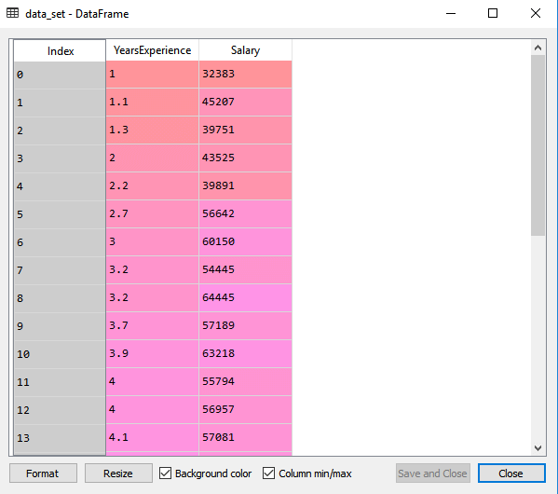

Slide 15
After that, we need to extract the dependent and independent variables from the given dataset. The independent variable is years of experience, and the dependent variable is salary. Below is code for it:
X = data_set.iloc[:, :-1].values
Y = data_set.iloc[:, 1].values
In the above lines of code, for x variable, we have taken -1 value since we want to remove the last column from the dataset. For y variable, we have taken 1 value as a parameter, since we want to extract the second column and indexing starts from the zero
By executing the above line of code, we will get the output for X and Y variable as:

Slide 16
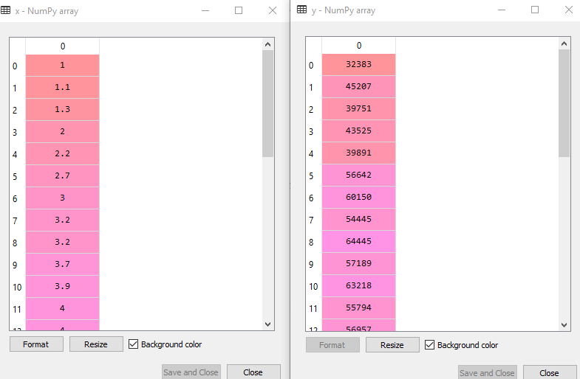
In the above output image, we can see the X (independent) variable and Y (dependent) variable has been extracted from the given dataset.

Slide 17
Next, we will split both variables into the test set and training set. We have 30 observations, so we will take 20 observations for the training set and 10 observations for the test set. We are splitting our dataset so that we can train our model using a training dataset and then test the model using a test dataset. The code for this is given below:
Splitting the dataset into training and test set.
from sklearn.model_selection import train_test_split
x_train, x_test, y_train, y_test= train_test_split(x, y, test_size= 1/3, random_state=0)
By executing the above code, we will get x-test, x-train and y-test, y-train dataset.
Consider the below images:

Slide 18
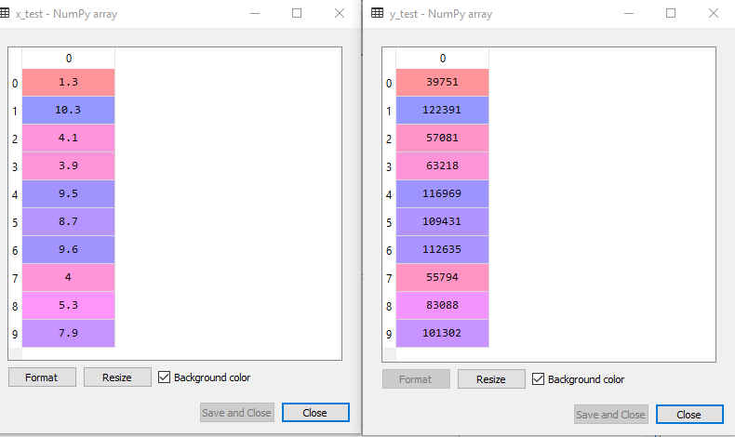
Test-dataset:

Slide 19
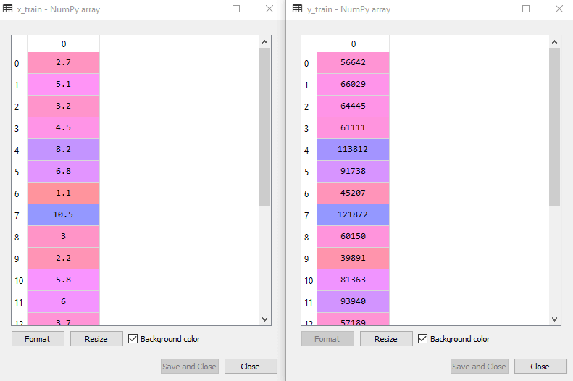
Training Dataset:
For simple linear Regression, we will not use Feature Scaling. Because Python libraries take care of it for some cases, so we don't need to perform it here. Now, our dataset is well prepared to work on it and we are going to start building a Simple Linear Regression model for the given problem.

Slide 20
Step-2: Fitting the Simple Linear Regression to the Training Set:
Now the second step is to fit our model to the training dataset. To do so, we will import the LinearRegression class of the linear_model library from the scikit learn. After importing the class, we are going to create an object of the class named as a regressor. The code for this is given below:
#Fitting the Simple Linear Regression model to the training dataset
from sklearn.linear_model import LinearRegression
regressor= LinearRegression()
regressor.fit(x_train, y_train)
In the above code, we have used a fit() method to fit our Simple Linear Regression object to the training set. In the fit() function, we have passed the x_train and y_train, which is our training dataset for the dependent and an independent variable. We have fitted our regressor object to the training set so that the model can easily learn the correlations between the predictor and target variables. After executing the above lines of code, we will get the below output.
Output:
LinearRegression(copy_X=True, fit_intercept=True, n_jobs=None, normalize=False)

Slide 21
Step: 3. Prediction of test set result:
Dependent (salary) and an independent variable (Experience).
So, now, our model is ready to predict the output for the new observations. In this step, we will provide the test dataset (new observations) to the model to check whether it can predict the correct output or not.
We will create a prediction vector y_pred, and x_pred, which will contain predictions of test dataset, and prediction of training set respectively.
#Prediction of Test and Training set result
y_pred= regressor.predict(x_test)
x_pred= regressor.predict(x_train)
On executing the above lines of code, two variables named y_pred and x_pred will generate in the variable explorer options that contain salary predictions for the training set and test set.

Slide 22
Output:
You can check the variable by clicking on the variable explorer option in the IDE, and also compare the result by comparing values from y_pred and y_test. By comparing these values, we can check how good our model is performing.
Step: 4. visualizing the Training set results:
Now in this step, we will visualize the training set result. To do so, we will use the scatter() function of the pyplot library, which we have already imported in the pre-processing step. The scatter () function will create a scatter plot of observations.
In the x-axis, we will plot the Years of Experience of employees and on the y-axis, salary of employees. In the function, we will pass the real values of training set, which means a year of experience x_train, training set of Salaries y_train, and color of the observations. Here we are taking a green color for the observation, but it can be any color as per the choice.
Now, we need to plot the regression line, so for this, we will use the plot() function of the pyplot library. In this function, we will pass the years of experience for training set, predicted salary for training set x_pred, and color of the line.
Next, we will give the title for the plot. So here, we will use the title() function of the pyplot library and pass the name ("Salary vs Experience (Training Dataset)".
After that, we will assign labels for x-axis and y-axis using xlabel() and ylabel() function.

Slide 23
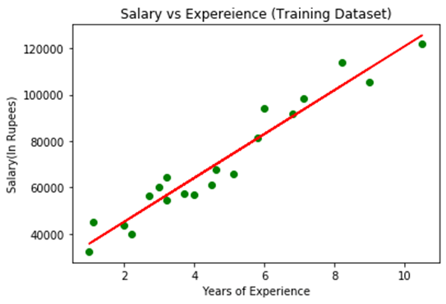
Finally, we will represent all above things in a graph using show(). The code is given below:
mtp.scatter(x_train, y_train, color="green")
mtp.plot(x_train, x_pred, color="red")
mtp.title("Salary vs Experience (Training Dataset)")
mtp.xlabel("Years of Experience")
mtp.ylabel("Salary(In Rupees)")
mtp.show()

Slide 24
In the above plot, we can see the real values observations in green dots and predicted values are covered by the red regression line. The regression line shows a correlation between the dependent and independent variable.
The good fit of the line can be observed by calculating the difference between actual values and predicted values. But as we can see in the above plot, most of the observations are close to the regression line, hence our model is good for the training set.
Step: 5. visualizing the Test set results:
In the previous step, we have visualized the performance of our model on the training set. Now, we will do the same for the Test set. The complete code will remain the same as the above code, except in this, we will use x_test, and y_test instead of x_train and y_train.
Here we are also changing the color of observations and regression line to differentiate between the two plots, but it is optional.

Slide 25
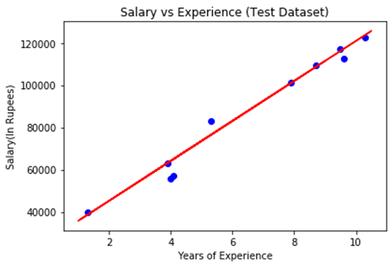
# visualizing the Test set results :
mtp.scatter(x_test, y_test, color="blue")
mtp.plot(x_train, x_pred, color="red")
mtp.title("Salary vs Experience (Test Dataset)")
mtp.xlabel("Years of Experience")
mtp.ylabel("Salary(In Rupees)")
mtp.show()

Slide 26
In the above plot, there are observations given by the blue color, and prediction is given by the red regression line. As we can see, most of the observations are close to the regression line, hence we can say our Simple Linear Regression is a good model and able to make good predictions.
Multiple Linear Regression:
In the previous topic, we have learned about Simple Linear Regression, where a single Independent/Predictor(X) variable is used to model the response variable (Y). But there may be various cases in which the response variable is affected by more than one predictor variable; for such cases, the Multiple Linear Regression algorithm is used.
Moreover, Multiple Linear Regression is an extension of Simple Linear regression as it takes more than one predictor variable to predict the response variable. We can define it as:
NOTE : Multiple Linear Regression is one of the important regression algorithms which models the linear relationship between a single dependent continuous variable and more than one independent variable.

Slide 27
Example:
Prediction of CO₂ emission based on engine size and number of cylinders in a car.
Some key points about MLR:
For MLR, the dependent or target variable(Y) must be the continuous/real, but the predictor or independent variable may be of continuous or categorical form.
Each feature variable must model the linear relationship with the dependent variable.
MLR tries to fit a regression line through a multidimensional space of data-points.
MLR equation:
In Multiple Linear Regression, the target variable(Y) is a linear combination of multiple predictor variables x₁, x₂, x₃, ...,x_{n}. Since it is an enhancement of Simple Linear Regression, so the same is applied for the multiple linear regression equation, the equation becomes:

Slide 28
Where,
Y = Output / Response variable
b₀, b₁, b₂, b₃ , b_{n}....= Coefficients of the model.
x₁, x₂, x₃, x₄,...= Various Independent / feature variable
Assumptions for Multiple Linear Regression:
A linear relationship should exist between the Target and predictor variables.
The regression residuals must be normally distributed.
MLR assumes little or no multicollinearity (correlation between the independent variable) in data.

Slide 29
Implementation of Multiple Linear Regression model using Python:
To implement MLR using Python, we have below problem:
Problem Description:
We have a dataset of 50 start-up companies. This dataset contains five main information: R&D Spend, Administration Spend, Marketing Spend, State, and Profit for a financial year. Our goal is to create a model that can easily determine which company has a maximum profit, and which is the most affecting factor for the profit of a company.
Since we need to find the Profit, so it is the dependent variable, and the other four variables are independent variables
Below are the main steps of deploying the MLR model:
Data Pre-processing Steps
Fitting the MLR model to the training set
Predicting the result of the test set
Step-1: Data Pre-processing Step:
The very first step is data pre-processing, which we have already discussed in this tutorial. This process contains the below steps:
Importing libraries: Firstly we will import the library which will help in building the model. Below is the code for it:

Slide 30
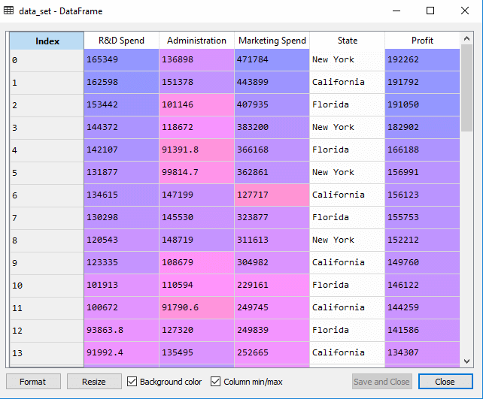
# importing libraries
import numpy as nm
import matplotlib.pyplot as mtp
import pandas as pd
Importing dataset: Now we will import the dataset(50_CompList), which contains all the variables. Below is the code for it:
# importing datasets
data_set= pd.read_csv('50_CompList.csv’)

Slide 31
In above output, we can clearly see that there are five variables, in which four variables are continuous and one is categorical variable.
Extracting dependent and independent Variables:
# Extracting Independent and dependent Variable
x= data_set.iloc[:, :-1].values
y= data_set.iloc[:, 4].values
As we can see in the above output, the last column contains categorical variables which are not suitable to apply directly for fitting the model. So we need to encode this variable.
Encoding Dummy Variables:
As we have one categorical variable (State), which cannot be directly applied to the model, so we will encode it. To encode the categorical variable into numbers, we will use the LabelEncoder class. But it is not sufficient because it still has some relational order, which may create a wrong model. So in order to remove this problem, we will use OneHotEncoder, which will create the dummy variables. Below is code for it

Slide 32
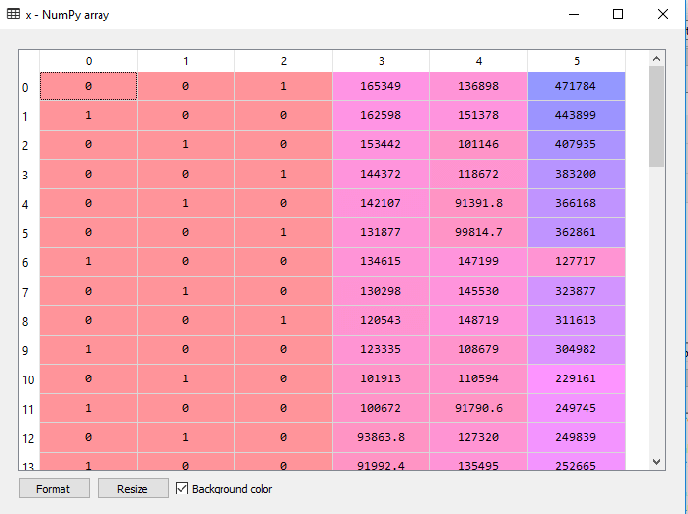
#Catgorical data
from sklearn.preprocessing import LabelEncoder, OneHotEncoder
labelencoder_x= LabelEncoder()
x[:, 3]= labelencoder_x.fit_transform(x[:,3])
onehotencoder= OneHotEncoder(categorical_features= [3])
x= onehotencoder.fit_transform(x).toarray()
Here we are only encoding one independent variable, which is state as other variables are continuous.
Output:

Slide 33
As we can see in the above output, the state column has been converted into dummy variables (0 and 1). Here each dummy variable column is corresponding to the one State. We can check by comparing it with the original dataset. The first column corresponds to the California State, the second column corresponds to the Florida State, and the third column corresponds to the New York State.
Note: We should not use all the dummy variables at the same time, so it must be 1 less than the total number of dummy variables, else it will create a dummy variable trap.
Now, we are writing a single line of code just to avoid the dummy variable trap:
# avoiding the dummy variable trap:
x = x[:, 1:]

Slide 34
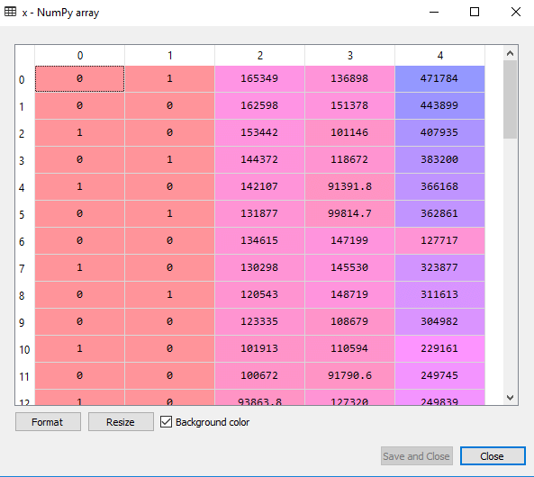
If we do not remove the first dummy variable, then it may introduce multicollinearity in the model.
The above output image, the first column has been removed as we can see in .

Slide 35
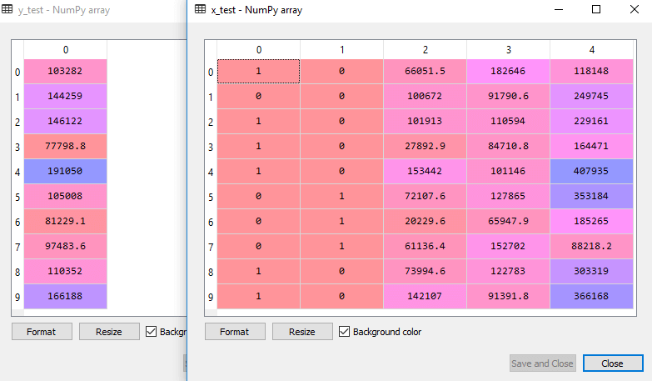
Now we will split the dataset into training and test set. The code for this is given below:
# Splitting the dataset into training and test set.
from sklearn.model_selection import train_test_split
x_train, x_test, y_train, y_test= train_test_split(x, y, test_size= 0.2, random_state=0)
Output: The above code will split the dataset into training set and test set. You can check the output by clicking on the variable explorer option given in Spyder IDE. The test set and training set will look like the below image:
Test set:

Slide 36
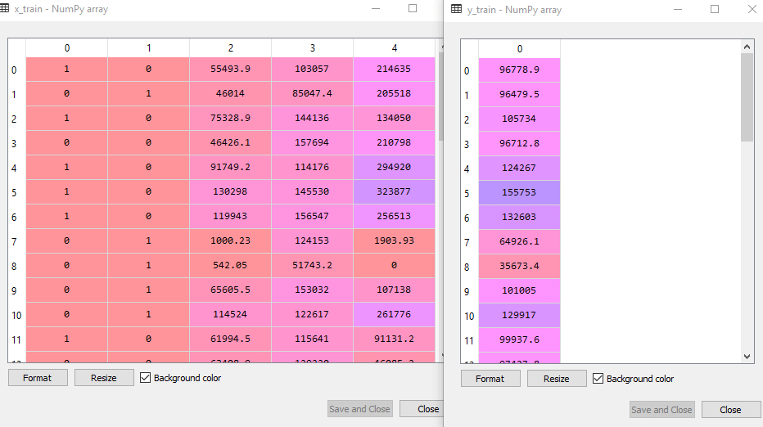
Training set:
Note: In MLR, we will not do feature scaling as it is taken care by the library, so we don't need to do it manually.

Slide 37
Step: 2- Fitting our MLR model to the Training set:
Now, we have well prepared our dataset in order to provide training, which means we will fit our regression model to the training set. It will be similar to as we did in Simple Linear Regression model. The code for this will be:
# Fitting the MLR model to the training set:
from sklearn.linear_model import LinearRegression
regressor= LinearRegression()
regressor.fit(x_train, y_train)
Output:
LinearRegression(copy_X=True, fit_intercept=True, n_jobs=None, normalize=False)
Now, we have successfully trained our model using the training dataset. In the next step, we will test the performance of the model using the test dataset.

Slide 38
Step: 3- Prediction of Test set results:
The last step for our model is checking the performance of the model. We will do it by predicting the test set result. For prediction, we will create a y_pred vector. Below is the code for it:
# Predicting the Test set result;
y_pred= regressor.predict(x_test)
By executing the above lines of code, a new vector will be generated under the variable explorer option. We can test our model by comparing the predicted values and test set values.
Output:

Slide 39
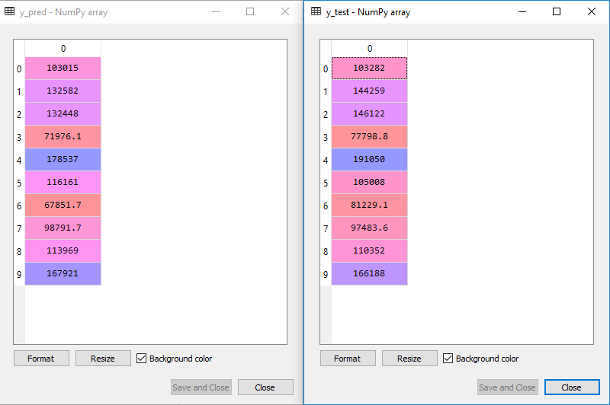
In the above output, we have predicted result set and test set. We can check model performance by comparing these two value index by index. For example, the first index has a predicted value of 103015$ profit and test/real value of 103282$ profit. The difference is only of 267$, which is a good prediction, so, finally, our model is completed here.

Slide 40
We can also check the score for training dataset and test dataset. Below is the code for it:
print('Train Score: ', regressor.score(x_train, y_train))
print('Test Score: ', regressor.score(x_test, y_test))
Output: The score is:
Train Score: 0.9501847627493607
Test Score: 0.9347068473282446
The above score tells that our model is 95% accurate with the training dataset and 93% accurate with the test dataset.
Applications of Multiple Linear Regression:
There are mainly two applications of Multiple Linear Regression:
Effectiveness of Independent variable on prediction:
Predicting the impact of changes:

Slide 41
What is Backward Elimination?
Backward elimination is a feature selection technique while building a machine learning model. It is used to remove those features that do not have a significant effect on the dependent variable or prediction of output. There are various ways to build a model in Machine Learning, which are:
All-in
Backward Elimination
Forward Selection
Bidirectional Elimination
Score Comparison
Above are the possible methods for building the model in Machine learning, but we will only use here the Backward Elimination process as it is the fastest method.

Slide 42
Steps of Backward Elimination
Below are some main steps which are used to apply backward elimination process:
Step-1: Firstly, We need to select a significance level to stay in the model. (SL=0.05)
Step-2: Fit the complete model with all possible predictors/independent variables.
Step-3: Choose the predictor which has the highest P-value, such that.
If P-value >SL, go to step 4.
Else Finish, and Our model is ready.
Step-4: Remove that predictor.
Step-5: Rebuild and fit the model with the remaining variables.

Slide 43
Need for Backward Elimination: An optimal Multiple Linear Regression model:
In the previous chapter, we discussed and successfully created our Multiple Linear Regression model, where we took 4 independent variables (R&D spend, Administration spend, Marketing spend, and state (dummy variables)) and one dependent variable (Profit).
But that model is not optimal, as we have included all the independent variables and do not know which independent model is most affecting and which one is the least affecting for the prediction.
Unnecessary features increase the complexity of the model. Hence it is good to have only the most significant features and keep our model simple to get the better result.
So, in order to optimize the performance of the model, we will use the Backward Elimination method.
This process is used to optimize the performance of the MLR model as it will only include the most affecting feature and remove the least affecting feature. Let's start to apply it to our MLR model.

Slide 44
Steps for Backward Elimination method:
We will use the same model which we build in the previous chapter of MLR. Below is the complete code for it:
# importing libraries
import numpy as nm
import matplotlib.pyplot as mtp
import pandas as pd
#importing datasets
data_set= pd.read_csv('50_CompList.csv')
# Extracting Independent and dependent Variable
x= data_set.iloc[:, :-1].values
y= data_set.iloc[:, 4].values
# Catgorical data
from sklearn.preprocessing import LabelEncoder, OneHotEncoder
labelencoder_x= LabelEncoder()
x[:, 3]= labelencoder_x.fit_transform(x[:,3])
onehotencoder= OneHotEncoder(categorical_features= [3])
x= onehotencoder.fit_transform(x).toarray()

Slide 45
# Avoiding the dummy variable trap:
x = x[:, 1:]
# Splitting the dataset into training and test set.
from sklearn.model_selection import train_test_split
x_train, x_test, y_train, y_test= train_test_split(x, y, test_size = 0.2, random_state = 0)
# Fitting the MLR model to the training set:
from sklearn.linear_model import LinearRegression
regressor= LinearRegression()
regressor.fit(x_train, y_train)
# Predicting the Test set result:
y_pred= regressor.predict(x_test)
# Checking the score
print('Train Score: ', regressor.score(x_train, y_train))
print('Test Score: ', regressor.score(x_test, y_test))

Slide 46
From the above code, we got training and test set result as:
Train Score: 0.9501847627493607
Test Score: 0.9347068473282446
The difference between both scores is 0.0154
Step: 1- Preparation of Backward Elimination:
Importing the library: Firstly, we need to import the statsmodels.formula.api library, which is used for the estimation of various statistical models such as OLS(Ordinary Least Square). Below is the code for it:
import statsmodels.api as smf
Adding a column in matrix of features: As we can check in our MLR equation (a), there is one constant term b₀, but this term is not present in our matrix of features, so we need to add it manually. We will add a column having values x₀ = 1 associated with the constant term b₀. To add this, we will use append function of Numpy library (nm which we have already imported into our code), and will assign a value of 1. Below is the code for it.

Slide 47
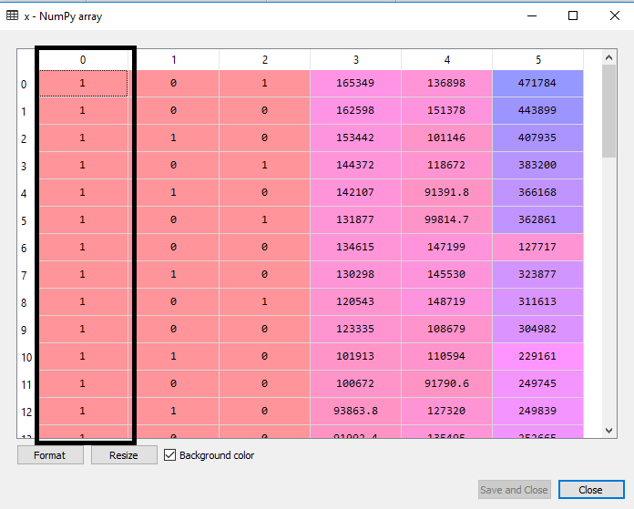
x = nm.append(arr = nm.ones((50,1)).astype(int), values=x, axis=1)
Here we have used axis =1, as we wanted to add a column. For adding a row, we can use axis =0.
Output: By executing the above line of code, a new column will be added into our matrix of features, which will have all values equal to 1. We can check it by clicking on the x dataset under the variable explorer option.
As we can see in the above output image, the first column is added successfully, which corresponds to the constant term of the MLR equation.

Slide 48
Step: 2:
Now, we are actually going to apply a backward elimination process. Firstly we will create a new feature vector x_opt, which will only contain a set of independent features that are significantly affecting the dependent variable.
Next, as per the Backward Elimination process, we need to choose a significant level(0.5), and then need to fit the model with all possible predictors. So for fitting the model, we will create a regressor_OLS object of new class OLS of statsmodels library. Then we will fit it by using the fit() method.
Next we need p-value to compare with SL value, so for this we will use summary() method to get the summary table of all the values. Below is the code for it
x_opt=x [:, [0,1,2,3,4,5]]
regressor_OLS=sm.OLS(endog = y, exog=x_opt).fit()
regressor_OLS.summary()
Output: By executing the above lines of code, we will get a summary table. Consider the below image:

Slide 49
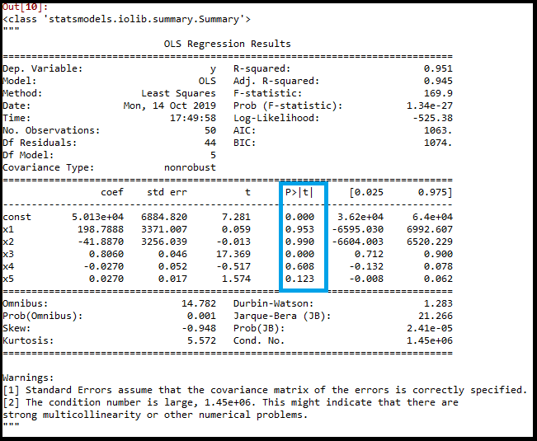

Slide 50
As we can see in the output image, now five variables remain. In these variables, the highest p-value is 0.961. So we will remove it in the next iteration.
Now the next highest value is 0.961 for x1 variable, which is another dummy variable. So we will remove it and refit the model. Below is the code for it:
# RESPECTIVE CODE:
x_opt= x[:, [0,3,4,5]]
regressor_OLS=sm.OLS(endog = y, exog=x_opt).fit()
regressor_OLS.summary()

Slide 51
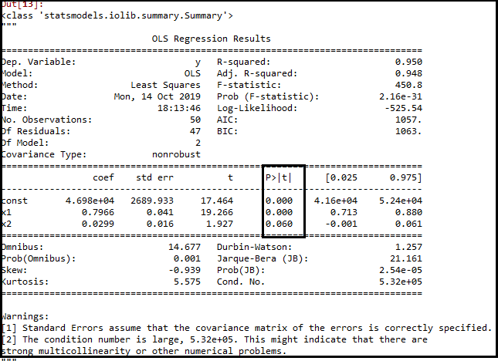
x_opt=x[:, [0,3,5]]
regressor_OLS=sm.OLS(endog = y, exog=x_opt).fit()
regressor_OLS.summary()

Slide 52
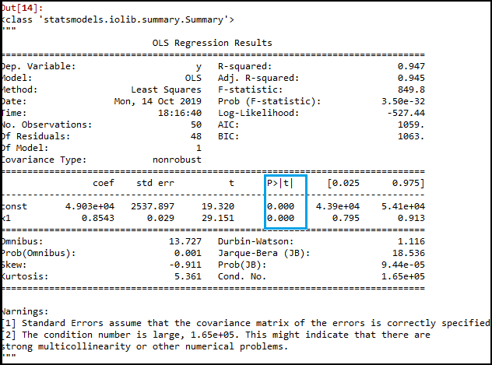
As we can see in the above output image, the variable (Admin spend) has been removed. But still, there is one variable left, which is marketing spend as it has a high p-value (0.60). So we need to remove it.
Finally, we will remove one more variable, which has .60 p-value for marketing spend, which is more than a significantlevel.
Below is the code for it:
x_opt=x[:, [0,3]]
regressor_OLS=sm.OLS(endog = y, exog=x_opt).fit()
regressor_OLS.summary()

Slide 53
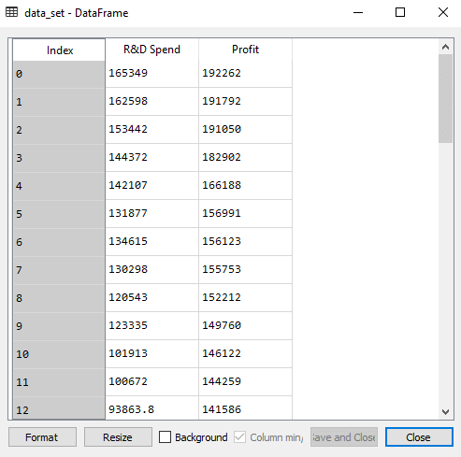
As we can see in the above output image, only two variables are left. So only the R&D independent variable is a significant variable for the prediction. So we can now predict efficiently using this variable.
Estimating the performance:
In the previous topic, we have calculated the train and test score of the model when we have used all the features variables. Now we will check the score with only one feature variable (R&D spend). Our dataset now looks like:

Slide 54
Below is the code for Building Multiple Linear Regression model by only using R&D spend:
# importing libraries
import numpy as nm
import matplotlib.pyplot as mtp
import pandas as pd
# importing datasets
data_set= pd.read_csv('50_CompList1.csv')
# Extracting Independent and dependent Variable
x_BE= data_set.iloc[:, :-1].values
y_BE= data_set.iloc[:, 1].values
# Splitting the dataset into training and test set.
from sklearn.model_selection import train_test_split
x_BE_train, x_BE_test, y_BE_train, y_BE_test= train_test_split(x_BE, y_BE, test_size= 0.2, random_state=0)

Slide 55
# Fitting the MLR model to the training set:
from sklearn.linear_model import LinearRegression
regressor= LinearRegression()
regressor.fit(nm.array(x_BE_train).reshape(-1,1), y_BE_train)
# Predicting the Test set result;
y_pred= regressor.predict(x_BE_test)
# Cheking the score
print('Train Score: ', regressor.score(x_BE_train, y_BE_train))
print('Test Score: ', regressor.score(x_BE_test, y_BE_test))
Output:
After executing the above code, we will get the Training and test scores as:
Train Score: 0.9449589778363044
Test Score: 0.9464587607787219
As we can see, the training score is 94% accurate, and the test score is also 94% accurate. The difference between both scores is .00149. This score is very much close to the previous score, i.e., 0.0154, where we have included all the variables.
We got this result by using one independent variable (R&D spend) only instead of four variables. Hence, now, our model is simple and accurate.

Slide 56
ML Polynomial Regression:
Polynomial Regression is a regression algorithm that models the relationship between a dependent(y) and independent variable(x) as nth degree polynomial. The Polynomial Regression equation is given below:
y= b0+b1x1+ b2x12+ b2x13+...... Bnx1n
It is also called the special case of Multiple Linear Regression in ML. Because we add some polynomial terms to the Multiple Linear regression equation to convert it into Polynomial Regression.
It is a linear model with some modification in order to increase the accuracy.
The dataset used in Polynomial regression for training is of non-linear nature.
It makes use of a linear regression model to fit the complicated and non-linear functions and datasets.
- Hence, "In Polynomial regression, the original features are converted into Polynomial features of required degree (2,3,..,n) and then modeled using a linear model."

Slide 57
Need for Polynomial Regression:
The need of Polynomial Regression in ML can be understood in the below points:
If we apply a linear model on a linear dataset, then it provides us a good result as we have seen in Simple Linear Regression, but if we apply the same model without any modification on a non-linear dataset, then it will produce a drastic output. Due to which loss function will increase, the error rate will be high, and accuracy will be decreased.
So for such cases, where data points are arranged in a non-linear fashion, we need the Polynomial Regression model. We can understand it in a better way using the below comparison diagram of the linear dataset and non-linear dataset.
we have taken a dataset which is arranged non-linearly. So if we try to cover it with a linear model, then we can clearly see that it hardly covers any data point. On the other hand, a curve is suitable to cover most of the data points, which is of the Polynomial model.
Hence, if the datasets are arranged in a non-linear fashion, then we should use the Polynomial Regression model instead of Simple Linear Regression.
Note: A Polynomial Regression algorithm is also called Polynomial Linear Regression because it does not depend on the variables, instead, it depends on the coefficients, which are arranged in a linear fashion

Slide 58
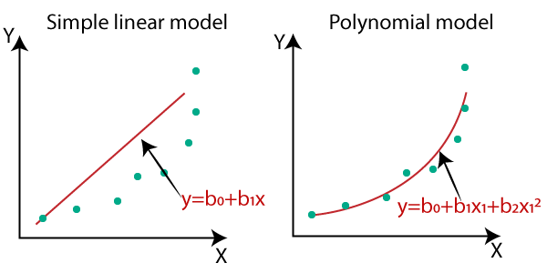
Equation of the Polynomial Regression Model:
Simple Linear Regression equation: y = b₀+b₁x .........(a)
Multiple Linear Regression equation: y= b₀+b₁x+ b₂x₂+b₃x₃+....+b_{n}x_{n} .........(b)
Polynomial Regression equation: y= b₀+b₁x + b₂x²+ b₃x³+....+ b_{n}x^{n} ..........(c)

Slide 59
When we compare the above three equations, we can clearly see that all three equations are Polynomial equations but differ by the degree of variables. The Simple and Multiple Linear equations are also Polynomial equations with a single degree, and the Polynomial regression equation is Linear equation with the nth degree. So if we add a degree to our linear equations, then it will be converted into Polynomial Linear equations.
Note: To better understand Polynomial Regression, you must have knowledge of Simple Linear Regression.
Implementation of Polynomial Regression using Python:
Here we will implement the Polynomial Regression using Python. We will understand it by comparing Polynomial Regression model with the Simple Linear Regression model. So first, let's understand the problem for which we are going to build the model.
Problem Description: There is a Human Resource company, which is going to hire a new candidate. The candidate has told his previous salary 160K per annum, and the HR have to check whether he is telling the truth or bluff. So to identify this, they only have a dataset of his previous company in which the salaries of the top 10 positions are mentioned with their levels. By checking the dataset available, we have found that there is a non-linear relationship between the Position levels and the salaries. Our goal is to build a Bluffing detector regression model, so HR can hire an honest candidate. Below are the steps to build such a model.

Slide 60
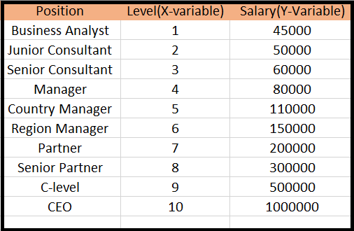

Slide 61
Steps for Polynomial Regression:
The main steps involved in Polynomial Regression are given below:
Data Pre-processing
Build a Linear Regression model and fit it to the dataset
Build a Polynomial Regression model and fit it to the dataset
Visualize the result for Linear Regression and Polynomial Regression model.
Predicting the output.
Note: Here, we will build the Linear regression model as well as Polynomial Regression to see the results between the predictions. And Linear regression model is for reference.
Data Pre-processing Step:
The data pre-processing step will remain the same as in previous regression models, except for some changes. In the Polynomial Regression model, we will not use feature scaling, and also we will not split our dataset into training and test set. It has two reasons:
The dataset contains very less information which is not suitable to divide it into a test and training set, else our model will not be able to find the correlations between the salaries and levels.
In this model, we want very accurate predictions for salary, so the model should have enough information.

Slide 62
The code for pre-processing step is given below:
# importing libraries
import numpy as nm
import matplotlib.pyplot as mtp
import pandas as pd
# importing datasets
data_set= pd.read_csv('Position_Salaries.csv')
# Extracting Independent and dependent Variable
x= data_set.iloc[:, 1:2].values
y= data_set.iloc[:, 2].values
Explanation:
In the above lines of code, we have imported the important Python libraries to import dataset and operate on it.
Next, we have imported the dataset 'Position_Salaries.csv', which contains three columns (Position, Levels, and Salary), but we will consider only two columns (Salary and Levels).
After that, we have extracted the dependent(Y) and independent variable(X) from the dataset. For x-variable, we have taken parameters as [:,1:2], because we want 1 index(levels), and included :2 to make it as a matrix.

Slide 63
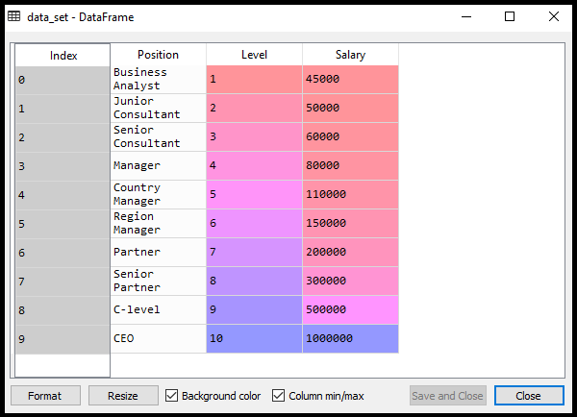
Output:
By executing the above code, we can read our dataset as:

Slide 64
As we can see in the above output, there are three columns present (Positions, Levels, and Salaries). But we are only considering two columns because Positions are equivalent to the levels or may be seen as the encoded form of Positions.
Here we will predict the output for level 6.5 because the candidate has 4+ years' experience as a regional manager, so he must be somewhere between levels 7 and 6.
Building the Linear regression model:
Now, we will build and fit the Linear regression model to the dataset. In building polynomial regression, we will take the Linear regression model as reference and compare both the results. The code is given below:
# Fitting the Linear Regression to the dataset
from sklearn.linear_model import LinearRegression
lin_regs= LinearRegression()
lin_regs.fit(x,y)
In the above code, we have created the Simple Linear model using lin_regs object of LinearRegression class and fitted it to the dataset variables (x and y).
Output:
LinearRegression(copy_X=True, fit_intercept=True, n_jobs=None, normalize=False)

Slide 65
Building the Polynomial regression model:
Now we will build the Polynomial Regression model, but it will be a little different from the Simple Linear model. Because here we will use PolynomialFeatures class of preprocessing library. We are using this class to add some extra features to our dataset.
# Fitting the Polynomial regression to the dataset
from sklearn.preprocessing import PolynomialFeatures
poly_regs= PolynomialFeatures(degree= 2)
x_poly= poly_regs.fit_transform(x)
lin_reg_2 =LinearRegression()
lin_reg_2.fit(x_poly, y)
In the above lines of code, we have used poly_regs.fit_transform(x), because first we are converting our feature matrix into polynomial feature matrix, and then fitting it to the Polynomial regression model. The parameter value(degree= 2) depends on our choice. We can choose it according to our Polynomial features.
After executing the code, we will get another matrix x_poly, which can be seen under the variable explorer option:

Slide 66
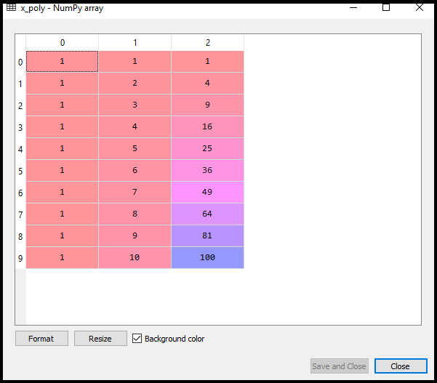
Next, we have used another LinearRegression object, namely lin_reg_2, to fit our x_poly vector to the linear model.
Output:
LinearRegression(copy_X=True, fit_intercept=True, n_jobs=None, normalize=False)

Slide 67
Visualizing the result for Linear regression:
Now we will visualize the result for Linear regression model as we did in Simple Linear Regression. Below is the code for it:
Visulaizing the result for Linear Regression model
mtp.scatter(x,y,color="blue")
mtp.plot(x,lin_regs.predict(x), color="red")
mtp.title("Bluff detection model(Linear Regression)")
mtp.xlabel("Position Levels")
mtp.ylabel("Salary")
mtp.show()

Slide 68
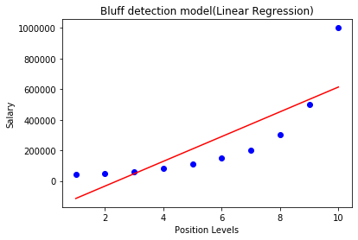
In the above output image, we can clearly see that the regression line is so far from the datasets. Predictions are in a red straight line, and blue points are actual values. If we consider this output to predict the value of CEO, it will give a salary of approx. 600000$, which is far away from the real value.
So we need a curved model to fit the dataset other than a straight line.

Slide 69
Visualizing the result for Polynomial Regression
Here we will visualize the result of Polynomial regression model, code for which is little different from the above model.
Code for this is given below:
# Visulaizing the result for Polynomial Regression
mtp.scatter(x,y,color="blue")
mtp.plot(x, lin_reg_2.predict(poly_regs.fit_transform(x)), color="red")
mtp.title("Bluff detection model(Polynomial Regression)")
mtp.xlabel("Position Levels")
mtp.ylabel("Salary")
mtp.show()

Slide 70
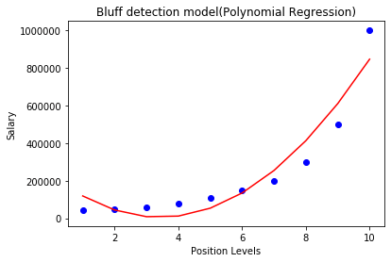
Output:
As we can see in the above output image, the predictions are close to the real values. The above plot will vary as we will change the degree.

Slide 71
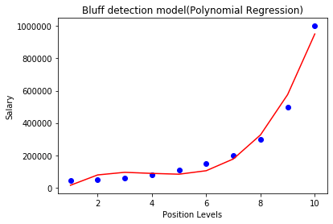
For degree= 3:
If we change the degree=3, then we will give a more accurate plot, as shown in the below image.
So as we can see here in the above output image, the predicted salary for level 6.5 is near to 170K$-190k$, which seems that future employee is saying the truth about his salary.

Slide 72
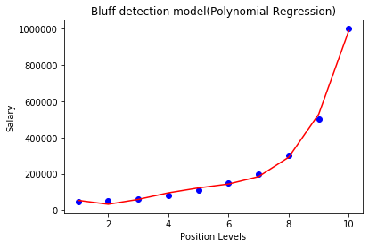
Degree= 4:
Let's again change the degree to 4, and now will get the most accurate plot. Hence we can get more accurate results by increasing the degree of Polynomial.

Slide 73
Predicting the final result with the Linear Regression model:
Now, we will predict the final output using the Linear regression model to see whether an employee is saying truth or bluff. So, for this, we will use the predict() method and will pass the value 6.5. Below is the code for it:
lin_pred = lin_regs.predict([[6.5]])
print(lin_pred)
Output:
[330378.78787879]
Predicting the final result with the Polynomial Regression model:
Now, we will predict the final output using the Polynomial Regression model to compare with Linear model. Below is the code for it:
poly_pred = lin_reg_2.predict(poly_regs.fit_transform([[6.5]]))
print(poly_pred)
Output:
[158862.45265153]

Slide 74
RESULT :
As we can see, the predicted output for the Polynomial Regression is [158862.45265153], which is much closer to real value hence, we can say that future employee is saying true.

Slide 75
SUPERVISED - CLASSIFICATION

Slide 76
Classification Algorithm in Machine Learning:
As we know, the Supervised Machine Learning algorithm can be broadly classified into Regression and Classification Algorithms. In Regression algorithms, we have predicted the output for continuous values, but to predict the categorical values, we need Classification algorithms.
What is the Classification Algorithm?
The Classification algorithm is a Supervised Learning technique that is used to identify the category of new observations on the basis of training data. In Classification, a program learns from the given dataset or observations and then classifies new observation into a number of classes or groups. Such as, Yes or No, 0 or 1, Spam or Not Spam, cat or dog, etc. Classes can be called as targets/labels or categories.
Unlike regression, the output variable of Classification is a category, not a value, such as "Green or Blue", "fruit or animal", etc. Since the Classification algorithm is a Supervised learning technique, hence it takes labeled input data, which means it contains input with the corresponding output.
In classification algorithm, a discrete output function(y) is mapped to input variable(x).

Slide 77
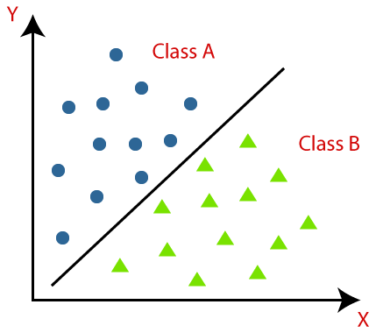
y=f(x), where y = categorical output
The best example of an ML classification algorithm is Email Spam Detector.
The main goal of the Classification algorithm is to identify the category of a given dataset, and these algorithms are mainly used to predict the output for the categorical data.
Classification algorithms can be better understood using the below diagram. In the below diagram, there are two classes, class A and Class B. These classes have features that are similar to each other and dissimilar to other classes.

Slide 78
The algorithm which implements the classification on a dataset is known as a classifier. There are two types of Classifications:
Binary Classifier: If the classification problem has only two possible outcomes, then it is called as Binary Classifier.
Examples: YES or NO, MALE or FEMALE, SPAM or NOT SPAM, CAT or DOG, etc.
Multi-class Classifier: If a classification problem has more than two outcomes, then it is called as Multi-class Classifier. Example: Classifications of types of crops, Classification of types of music.
Learners in Classification Problems:
In the classification problems, there are two types of learners:
Lazy Learners: Lazy Learner firstly stores the training dataset and wait until it receives the test dataset. In Lazy learner case, classification is done on the basis of the most related data stored in the training dataset. It takes less time in training but more time for predictions. Example: K-NN algorithm, Case-based reasoning
Eager Learners:Eager Learners develop a classification model based on a training dataset before receiving a test dataset. Opposite to Lazy learners, Eager Learner takes more time in learning, and less time in prediction. Example: Decision Trees, Naïve Bayes, ANN.

Slide 79
Types of ML Classification Algorithms:
Classification Algorithms can be further divided into the Mainly two category:
Linear Models
Logistic Regression
Support Vector Machines
Non-linear Models
K-Nearest Neighbours
Kernel SVM
Naïve Bayes
Decision Tree Classification
Random Forest Classification
Evaluating a Classification model:
Once our model is completed, it is necessary to evaluate its performance; either it is a Classification or Regression model. So for evaluating a Classification model, we have the following ways:
Log Loss or Cross-Entropy Loss:
It is used for evaluating the performance of a classifier, whose output is a probability value between the 0 and 1.
For a good binary Classification model, the value of log loss should be near to 0.
The value of log loss increases if the predicted value deviates from the actual value.
The lower log loss represents the higher accuracy of the model.

Slide 80

2. Confusion Matrix:
The confusion matrix provides us a matrix/table as output and describes the performance of the model.
It is also known as the error matrix.
The matrix consists of predictions result in a summarized form, which has a total number of correct predictions and incorrect predictions. The matrix looks like as below table:
 | ACTUAL POSITIVE | ACTUAL NEGATIVE
PREDICTED POSTIVE | TRUE POSITIVE | FALSE POSITIVE
PREDICTED NEGATIVE | FALSE NEGATIVE | TRUE NEGATIVE

Slide 81
3. AUC-ROC curve:
ROC curve stands for Receiver Operating Characteristics Curve and AUC stands for Area Under the Curve.
It is a graph that shows the performance of the classification model at different thresholds.
To visualize the performance of the multi-class classification model, we use the AUC-ROC Curve.
The ROC curve is plotted with TPR and FPR, where TPR (True Positive Rate) on Y-axis and FPR(False Positive Rate) on X-axis.
Use cases of Classification Algorithms:
Classification algorithms can be used in different places. Below are some popular use cases of Classification Algorithms:
Email Spam Detection
Speech Recognition
Identifications of Cancer tumor cells.
Drugs Classification
Biometric Identification, etc.

Slide 82
Logistic Regression in Machine Learning:
Logistic regression is one of the most popular Machine Learning algorithms, which comes under the Supervised Learning technique. It is used for predicting the categorical dependent variable using a given set of independent variables.
Logistic regression predicts the output of a categorical dependent variable. Therefore the outcome must be a categorical or discrete value. It can be either Yes or No, 0 or 1, true or False, etc. but instead of giving the exact value as 0 and 1, it gives the probabilistic values which lie between 0 and 1.
Logistic Regression is much similar to the Linear Regression except that how they are used. Linear Regression is used for solving Regression problems, whereas Logistic regression is used for solving the classification problems.
In Logistic regression, instead of fitting a regression line, we fit an "S" shaped logistic function, which predicts two maximum values (0 or 1).
The curve from the logistic function indicates the likelihood of something such as whether the cells are cancerous or not, a mouse is obese or not based on its weight, etc.
Logistic Regression is a significant machine learning algorithm because it has the ability to provide probabilities and classify new data using continuous and discrete datasets.
Logistic Regression can be used to classify the observations using different types of data and can easily determine the most effective variables used for the classification. The below image is showing the logistic function:

Slide 83
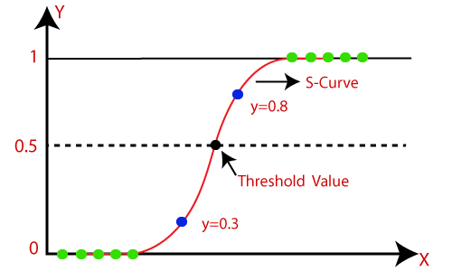
Logistic Function (Sigmoid Function):
The sigmoid function is a mathematical function used to map the predicted values to probabilities.
It maps any real value into another value within a range of 0 and 1.
The value of the logistic regression must be between 0 and 1, which cannot go beyond this limit, so it forms a curve like the "S" form. The S-form curve is called the Sigmoid function or the logistic function.
In logistic regression, we use the concept of the threshold value, which defines the probability of either 0 or 1. Such as values above the threshold value tends to 1, and a value below the threshold values tends to 0.
Note: Logistic regression uses the concept of predictive modeling as regression; therefore, it is called logistic regression, but is used to classify samples; Therefore, it falls under the classification algorithm.

Slide 84
Logistic Function (Sigmoid Function):
The sigmoid function is a mathematical function used to map the predicted values to probabilities.
It maps any real value into another value within a range of 0 and 1
The value of the logistic regression must be between 0 and 1, which cannot go beyond this limit, so it forms a curve like the "S" form. The S-form curve is called the Sigmoid function or the logistic function.
In logistic regression, we use the concept of the threshold value, which defines the probability of either 0 or 1. Such as values above the threshold value tends to 1, and a value below the threshold values tends to 0.
Assumptions for Logistic Regression:
The dependent variable must be categorical in nature.
The independent variable should not have multi-collinearity.

Slide 85


Logistic Regression Equation:
The Logistic regression equation can be obtained from the Linear Regression equation. The mathematical steps to get Logistic Regression equations are given below:
We know the equation of the straight line can be written as:
In Logistic Regression y can be between 0 and 1 only, so for this let's divide the above equation by (1-y):
But we need range between -[infinity] to +[infinity], then take logarithm of the equation it will become:
The above equation is the final equation for Logistic Regression.

Slide 86
Type of Logistic Regression:
Binomial: In binomial Logistic regression, there can be only two possible types of the dependent variables, such as 0 or 1, Pass or Fail, etc.
Multinomial: In multinomial Logistic regression, there can be 3 or more possible unordered types of the dependent variable, such as "cat", "dogs", or "sheep“
Ordinal: In ordinal Logistic regression, there can be 3 or more possible ordered types of dependent variables, such as "low", "Medium", or "High".

Slide 87
Python Implementation of Logistic Regression (Binomial):
To understand the implementation of Logistic Regression in Python, we will use the below example:
Example: There is a dataset given which contains the information of various users obtained from the social networking sites. There is a car making company that has recently launched a new SUV car. So the company wanted to check how many users from the dataset, wants to purchase the car.
For this problem, we will build a Machine Learning model using the Logistic regression algorithm. The dataset is shown in the below image. In this problem, we will predict the purchased variable (Dependent Variable) by using age and salary (Independent variables).

Slide 88
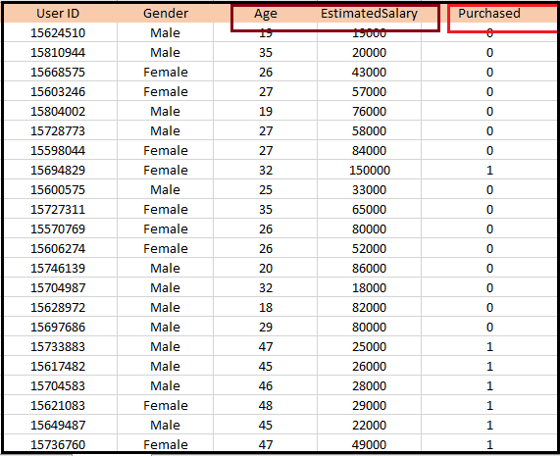

Slide 89
Steps in Logistic Regression:
Data Pre-processing step
Fitting Logistic Regression to the Training set
Predicting the test result
Test accuracy of the result(Creation of Confusion matrix)

Slide 90
Data Pre-processing step:
In this step, we will pre-process/prepare the data so that we can use it in our code efficiently. It will be the same as we have done in Data pre-processing topic. The code for this is given below:
# importing libraries
import numpy as nm
import matplotlib.pyplot as mtp
import pandas as pd
# importing datasets
data_set= pd.read_csv('user_data.csv')

Slide 91
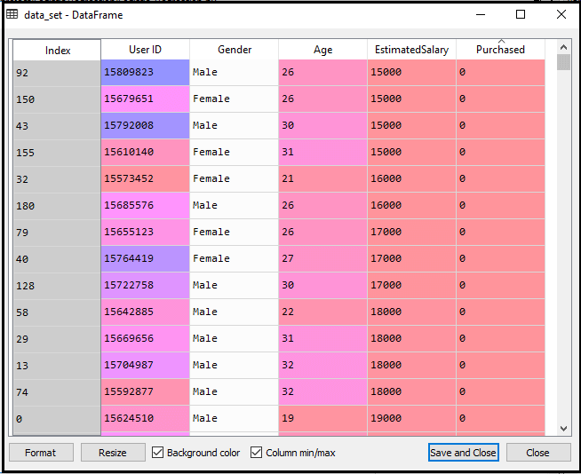

Slide 92
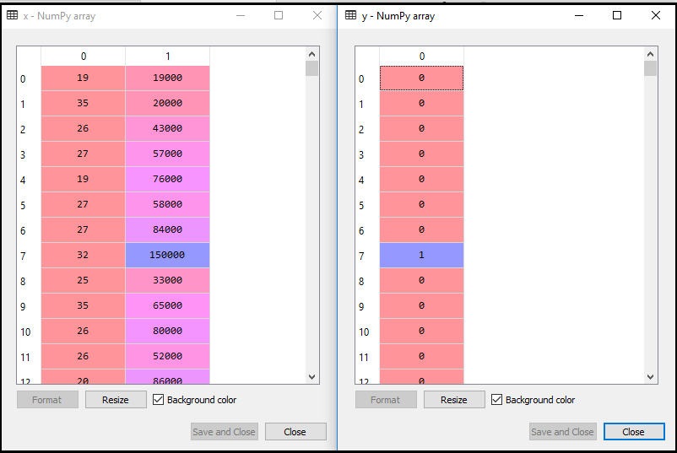
Now, we will extract the dependent and independent variables from the given dataset. Below is the code for it:
#Extracting Independent and dependent Variable
x= data_set.iloc[:, [2,3]].values
y= data_set.iloc[:, 4].values
In the above code, we have taken [2, 3] for x because our independent variables are age and salary, which are at index 2, 3. And we have taken 4 for y variable because our dependent variable is at index 4. The output will be:

Slide 93
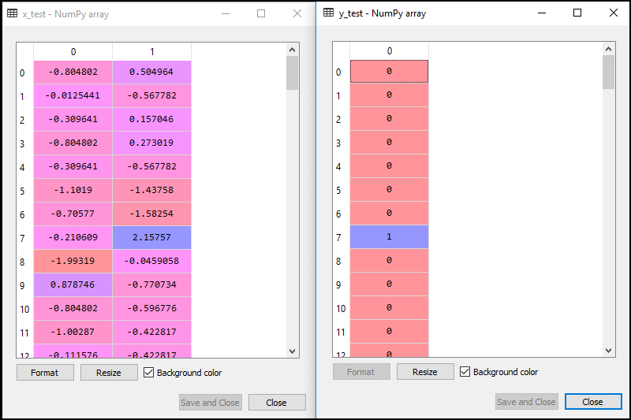
Now we will split the dataset into a training set and test set. Below is the code for it
# Splitting the dataset into training and test set.
from sklearn.model_selection import train_test_split
x_train, x_test, y_train, y_test= train_test_split(x, y, test_size= 0.25, random_state=0)
For test set: For training set:

Slide 94
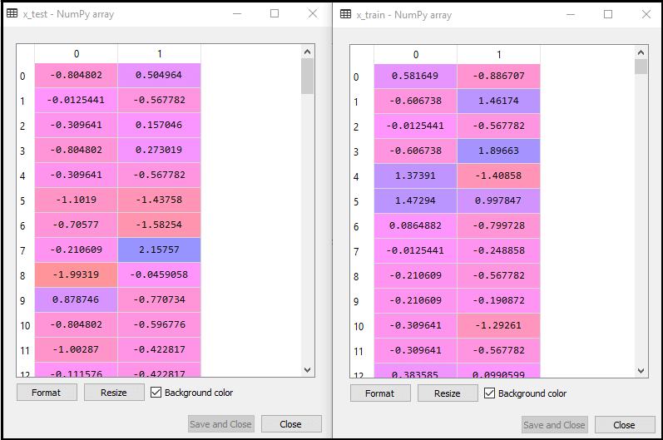
In logistic regression, we will do feature scaling because we want accurate result of predictions. Here we will only scale the independent variable because dependent variable have only 0 and 1 values. Below is the code for it:
# feature Scaling
from sklearn.preprocessing import StandardScaler
st_x= StandardScaler()
x_train= st_x.fit_transform(x_train)
x_test= st_x.transform(x_test)

Slide 95
2. Fitting Logistic Regression to the Training set:
We have well prepared our dataset, and now we will train the dataset using the training set. For providing training or fitting the model to the training set, we will import the LogisticRegression class of the sklearn library.
After importing the class, we will create a classifier object and use it to fit the model to the logistic regression. Below is the code for it:
# Fitting Logistic Regression to the training set
from sklearn.linear_model import LogisticRegression
classifier= LogisticRegression(random_state=0)
classifier.fit(x_train, y_train)
Output: By executing the above code, we will get the below output:
LogisticRegression(C=1.0, class_weight=None, dual=False, fit_intercept=True,
intercept_scaling=1, l1_ratio=None, max_iter=100,
multi_class='warn', n_jobs=None, penalty='l2',
random_state=0, solver='warn', tol=0.0001, verbose=0,
warm_start=False)
Hence our model is well fitted to the training set.

Slide 96
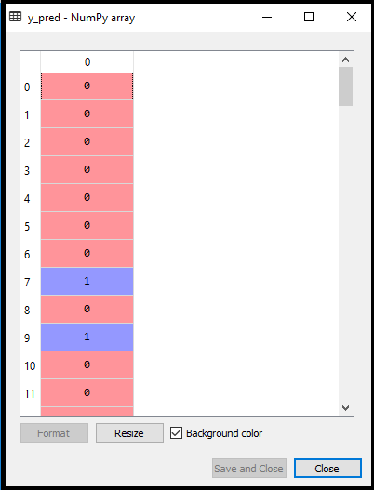
3. Predicting the Test Result
Our model is well trained on the training set, so we will now predict the result by using test set data. Below is the code for it:
#Predicting the test set result
y_pred= classifier.predict(x_test)
In the above code, we have created a y_pred vector to predict the test set result.
Output: By executing the above code, a new vector (y_pred) will be created under the variable explorer option.
The output image shows the corresponding predicted users who want to purchase or not purchase the car.

Slide 97
4. Test Accuracy of the result
Now we will create the confusion matrix here to check the accuracy of the classification. To create it, we need to import the confusion_matrix function of the sklearn library. After importing the function, we will call it using a new variable cm. The function takes two parameters, mainly y_true( the actual values) and y_pred (the targeted value return by the classifier). Below is the code for it:
# Creating the Confusion matrix
from sklearn.metrics import confusion_matrix
cm = confusion_matrix()
Output:
By executing the above code, a new confusion matrix will be created. Consider the below image:

Slide 98
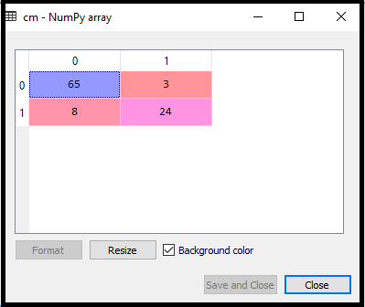
We can find the accuracy of the predicted result by interpreting the confusion matrix. By above output, we can interpret that 65+24= 89 (Correct Output) and 8+3= 11(Incorrect Output).

Slide 99
5. Visualizing the training set result:
# Visualizing the training set result
from matplotlib.colors import ListedColormap
x_set, y_set = x_train, y_train
x1, x2 = nm.meshgrid(nm.arange(start = x_set[:, 0].min() - 1, stop = x_set[:, 0].max() + 1, step =0.01),
nm.arange(start = x_set[:, 1].min() - 1, stop = x_set[:, 1].max() + 1, step = 0.01))
mtp.contourf(x1, x2, classifier.predict(nm.array([x1.ravel(), x2.ravel()]).T).reshape(x1.shape),
alpha = 0.75, cmap = ListedColormap(('purple','green' )))
mtp.xlim(x1.min(), x1.max())
mtp.ylim(x2.min(), x2.max())
for i, j in enumerate(nm.unique(y_set)):
mtp.scatter(x_set[y_set == j, 0], x_set[y_set == j, 1],
c = ListedColormap(('purple', 'green'))(i), label = j)
mtp.title('Logistic Regression (Training set)')
mtp.xlabel('Age')
mtp.ylabel('Estimated Salary')
mtp.legend()
mtp.show()

Slide 100
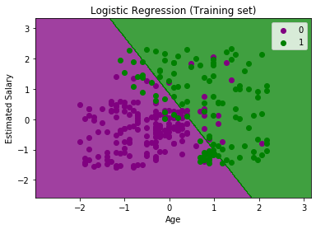
In the above code, we have imported the ListedColormap class of Matplotlib library to create the colormap for visualizing the result. We have created two new variables x_set and y_set to replace x_train and y_train. After that, we have used the nm.meshgrid command to create a rectangular grid, which has a range of -1(minimum) to 1 (maximum). The pixel points we have taken are of 0.01 resolution.
To create a filled contour, we have used mtp.contourf command, it will create regions of provided colors (purple and green). In this function, we have passed the classifier.predict to show the predicted data points predicted by the classifier.
Output: By executing the above code, we will get the below output:

Slide 101
The graph can be explained in the below points:
In the above graph, we can see that there are some Green points within the green region and Purple points within the purple region.
All these data points are the observation points from the training set, which shows the result for purchased variables.
This graph is made by using two independent variables i.e., Age on the x-axis and Estimated salary on the y-axis.
The purple point observations are for which purchased (dependent variable) is probably 0, i.e., users who did not purchase the SUV car.
The green point observations are for which purchased (dependent variable) is probably 1 means user who purchased the SUV car.
We can also estimate from the graph that the users who are younger with low salary, did not purchase the car, whereas older users with high estimated salary purchased the car.
But there are some purple points in the green region (Buying the car) and some green points in the purple region(Not buying the car). So we can say that younger users with a high estimated salary purchased the car, whereas an older user with a low estimated salary did not purchase the car.

Slide 102
The goal of the classifier:
We have successfully visualized the training set result for the logistic regression, and our goal for this classification is to divide the users who purchased the SUV car and who did not purchase the car. So from the output graph, we can clearly see the two regions (Purple and Green) with the observation points. The Purple region is for those users who didn't buy the car, and Green Region is for those users who purchased the car.

Slide 103
Linear Classifier:
As we can see from the graph, the classifier is a Straight line or linear in nature as we have used the Linear model for Logistic Regression. In further topics, we will learn for non-linear Classifiers.
Visualizing the test set result:
Our model is well trained using the training dataset. Now, we will visualize the result for new observations (Test set). The code for the test set will remain same as above except that here we will use x_test and y_test instead of x_train and y_train. Below is the code for it:

Slide 104
# Visulaizing the test set result
from matplotlib.colors import ListedColormap
x_set, y_set = x_test, y_test
x1, x2 = nm.meshgrid(nm.arange(start = x_set[:, 0].min() - 1, stop = x_set[:, 0].max() + 1, step =0.01),
nm.arange(start = x_set[:, 1].min() - 1, stop = x_set[:, 1].max() + 1, step = 0.01))
mtp.contourf(x1, x2, classifier.predict(nm.array([x1.ravel(), x2.ravel()]).T).reshape(x1.shape),
alpha = 0.75, cmap = ListedColormap(('purple','green' )))
mtp.xlim(x1.min(), x1.max())
mtp.ylim(x2.min(), x2.max())
for i, j in enumerate(nm.unique(y_set)):
mtp.scatter(x_set[y_set == j, 0], x_set[y_set == j, 1],
c = ListedColormap(('purple', 'green'))(i), label = j)
mtp.title('Logistic Regression (Test set)')
mtp.xlabel('Age')
mtp.ylabel('Estimated Salary')
mtp.legend()
mtp.show()

Slide 105
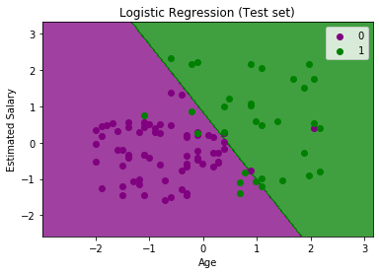
Output:
The above graph shows the test set result. As we can see, the graph is divided into two regions (Purple and Green). And Green observations are in the green region, and Purple observations are in the purple region. So we can say it is a good prediction and model. Some of the green and purple data points are in different regions, which can be ignored as we have already calculated this error using the confusion matrix (11 Incorrect output).
Hence our model is pretty good and ready to make new predictions for this classification problem.

Slide 106
K-Nearest Neighbor(KNN) Algorithm for Machine Learning

Slide 107
K-Nearest Neighbor(KNN) Algorithm for Machine Learning:
K-Nearest Neighbour is one of the simplest Machine Learning algorithms based on Supervised Learning technique.
K-NN algorithm assumes the similarity between the new case/data and available cases and put the new case into the category that is most similar to the available categories.
K-NN algorithm stores all the available data and classifies a new data point based on the similarity. This means when new data appears then it can be easily classified into a well suite category by using K- NN algorithm.
K-NN algorithm can be used for Regression as well as for Classification but mostly it is used for the Classification problems.
K-NN is a non-parametric algorithm, which means it does not make any assumption on underlying data.
It is also called a lazy learner algorithm because it does not learn from the training set immediately instead it stores the dataset and at the time of classification, it performs an action on the dataset.
KNN algorithm at the training phase just stores the dataset and when it gets new data, then it classifies that data into a category that is much similar to the new data.

Slide 108
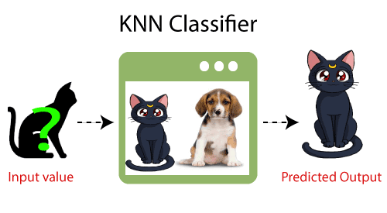
Example:
Suppose, we have an image of a creature that looks similar to cat and dog, but we want to know either it is a cat or dog. So for this identification, we can use the KNN algorithm, as it works on a similarity measure. Our KNN model will find the similar features of the new data set to the cats and dogs images and based on the most similar features it will put it in either cat or dog category.

Slide 109
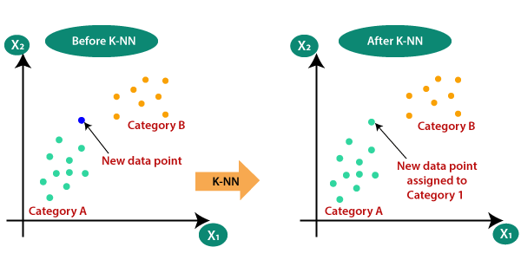
Why do we need a K-NN Algorithm?
Suppose there are two categories, i.e., Category A and Category B, and we have a new data point x1, so this data point will lie in which of these categories. To solve this type of problem, we need a K-NN algorithm. With the help of K-NN, we can easily identify the category or class of a particular dataset.
Consider the below diagram:

Slide 110
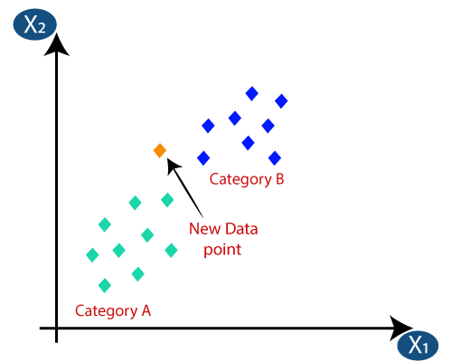
How does K-NN work?
The K-NN working can be explained on the basis of the below algorithm:
Step-1: Select the number K of the neighbors
Step-2: Calculate the Euclidean distance of K number of neighbors
Step-3: Take the K nearest neighbors as per the calculated Euclidean distance.
Step-4: Among these k neighbors, count the number of the data points in each category.
Step-5: Assign the new data points to that category for which the number of the neighbor is maximum.
Step-6: Our model is ready.
Suppose we have a new data point and we need to put it in the required category. Consider the below image:

Slide 111
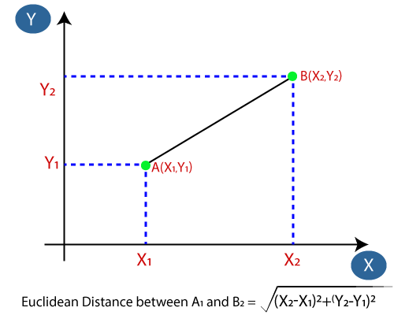
Firstly, we will choose the number of neighbors, so we will choose the k=5.
Next, we will calculate the Euclidean distance between the data points. The Euclidean distance is the distance between two points, which we have already studied in geometry. It can be calculated as:

Slide 112
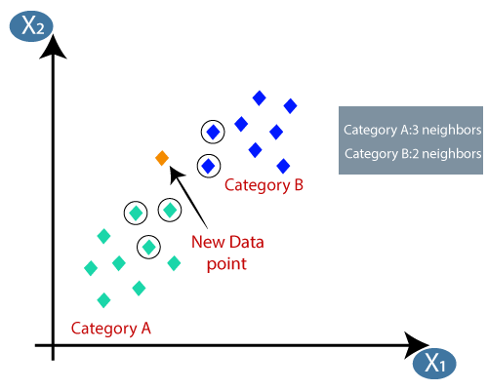
By calculating the Euclidean distance we got the nearest neighbors, as three nearest neighbors in category A and two nearest neighbors in category B.
Consider the below image:
As we can see the 3 nearest neighbors are from category A, hence this new data point must belong to category A.

Slide 113
How to select the value of K in the K-NN Algorithm?
There is no particular way to determine the best value for "K", so we need to try some values to find the best out of them. The most preferred value for K is 5.
A very low value for K such as K=1 or K=2, can be noisy and lead to the effects of outliers in the model.
Large values for K are good, but it may find some difficulties.
Advantages of KNN Algorithm:
It is simple to implement.
It is robust to the noisy training data
It can be more effective if the training data is large.
Disadvantages of KNN Algorithm:
Always needs to determine the value of K which may be complex some time.
The computation cost is high because of calculating the distance between the data points for all the training samples.

Slide 114
Python implementation of the KNN algorithm:
To do the Python implementation of the K-NN algorithm, we will use the same problem and dataset which we have used in Logistic Regression. But here we will improve the performance of the model. Below is the problem description
Problem for K-NN Algorithm: There is a Car manufacturer company that has manufactured a new SUV car. The company wants to give the ads to the users who are interested in buying that SUV. So for this problem, we have a dataset that contains multiple user's information through the social network. The dataset contains lots of information but the Estimated Salary and Age we will consider for the independent variable and the Purchased variable is for the dependent variable. Below is the dataset:

Slide 115
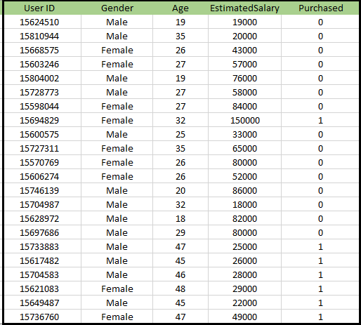

Slide 116
Steps to implement the K-NN algorithm:
Data Pre-processing step
Fitting the K-NN algorithm to the Training set
Predicting the test result
Test accuracy of the result(Creation of Confusion matrix)

Slide 117
Data Pre-Processing Step:
# importing libraries
import numpy as nm
import matplotlib.pyplot as mtp
import pandas as pd
#importing datasets
data_set= pd.read_csv('user_data.csv')
#Extracting Independent and dependent Variable
x= data_set.iloc[:, [2,3]].values
y= data_set.iloc[:, 4].values
# Splitting the dataset into training and test set.
from sklearn.model_selection import train_test_split
x_train, x_test, y_train, y_test= train_test_split(x, y, test_size= 0.25, random_state=0)
#feature Scaling
from sklearn.preprocessing import StandardScaler
st_x= StandardScaler()
x_train= st_x.fit_transform(x_train)
x_test= st_x.transform(x_test)

Slide 118
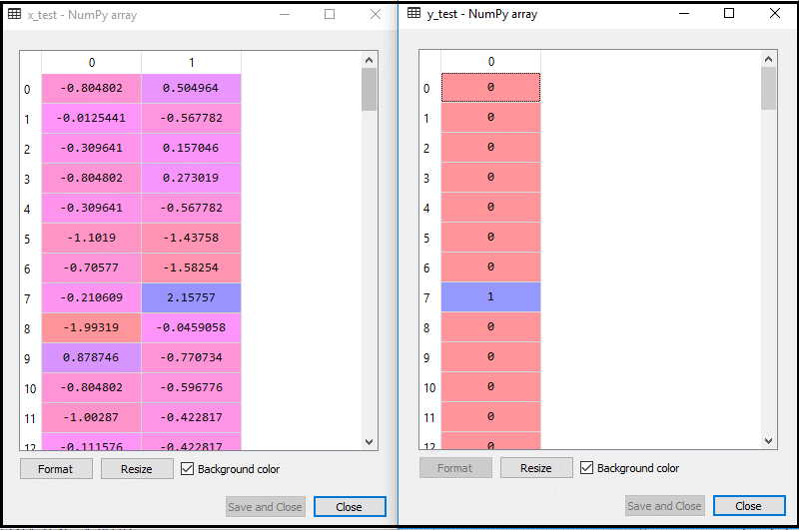
By executing the above code, our dataset is imported to our program and well pre-processed. After feature scaling our test dataset will look like:

Slide 119
Fitting K-NN classifier to the Training data:
Now we will fit the K-NN classifier to the training data. To do this we will import the KNeighborsClassifier class of Sklearn Neighbors library. After importing the class, we will create the Classifier object of the class. The Parameter of this class will be
n_neighbors: To define the required neighbors of the algorithm. Usually, it takes 5.
metric='minkowski': This is the default parameter and it decides the distance between the points.
p=2: It is equivalent to the standard Euclidean metric.
And then we will fit the classifier to the training data. Below is the code for it:
#Fitting K-NN classifier to the training set
from sklearn.neighbors import KNeighborsClassifier
classifier= KNeighborsClassifier(n_neighbors=5, metric='minkowski', p=2 )
classifier.fit(x_train, y_train)
Output: By executing the above code, we will get the output as:
KNeighborsClassifier(algorithm='auto', leaf_size=30, metric='minkowski',
metric_params=None, n_jobs=None, n_neighbors=5, p=2,
weights='uniform')

Slide 120
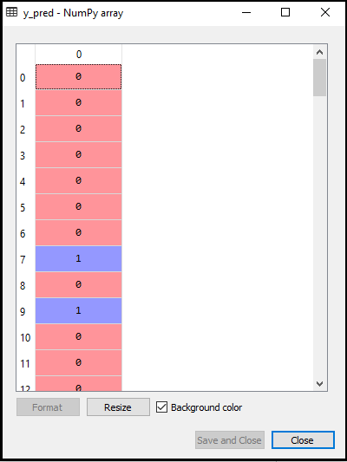
Predicting the Test Result:
To predict the test set result, we will create a y_pred vector as we did in Logistic Regression. Below is the code for it:
#Predicting the test set result
y_pred= classifier.predict(x_test)
Output:

Slide 121
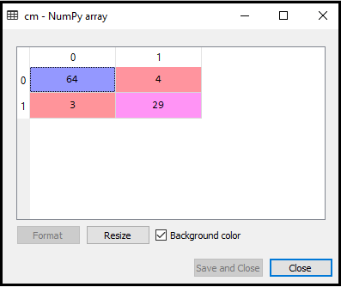
Creating the Confusion Matrix:
Now we will create the Confusion Matrix for our K-NN model to see the accuracy of the classifier. Below is the code for it:
from sklearn.metrics import confusion_matrix
cm= confusion_matrix(y_test, y_pred)
Output:
we can see there are 64+29= 93 correct predictions and 3+4= 7 incorrect predictions, whereas, in Logistic Regression, there were 11 incorrect predictions. So we can say that the performance of the model is improved by using the K-NN algorithm.

Slide 122
Visualizing the Training set result:
Now, we will visualize the training set result for K-NN model. The code will remain same as we did in Logistic Regression, except the name of the graph.
from matplotlib.colors import ListedColormap
x_set, y_set = x_train, y_train
x1, x2 = nm.meshgrid(nm.arange(start = x_set[:, 0].min() - 1, stop = x_set[:, 0].max() + 1, step =0.01),
nm.arange(start = x_set[:, 1].min() - 1, stop = x_set[:, 1].max() + 1, step = 0.01))
mtp.contourf(x1, x2, classifier.predict(nm.array([x1.ravel(), x2.ravel()]).T).reshape(x1.shape),
alpha = 0.75, cmap = ListedColormap(('red','green' )))
mtp.xlim(x1.min(), x1.max())
mtp.ylim(x2.min(), x2.max())
for i, j in enumerate(nm.unique(y_set)):
mtp.scatter(x_set[y_set == j, 0], x_set[y_set == j, 1],
c = ListedColormap(('red', 'green'))(i), label = j)
mtp.title('K-NN Algorithm (Training set)')
mtp.xlabel('Age')
mtp.ylabel('Estimated Salary')
mtp.legend()
mtp.show()

Slide 123
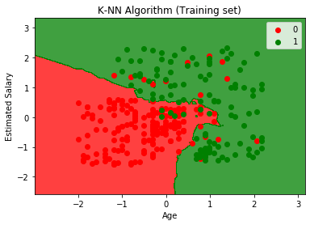
Output:
The output graph is different from the graph which we have occurred in Logistic Regression. It can be understood in the below points:
As we can see the graph is showing the red point and green points. The green points are for Purchased(1) and Red Points for not Purchased(0) variable.
The graph is showing an irregular boundary instead of showing any straight line or any curve because it is a K-NN algorithm, i.e., finding the nearest neighbor.
The graph has classified users in the correct categories as most of the users who didn't buy the SUV are in the red region and users who bought the SUV are in the green region.
The graph is showing good result but still, there are some green points in the red region and red points in the green region. But this is no big issue as by doing this model is prevented from overfitting issues.
Hence our model is well trained.

Slide 124
Visualizing the Test set result:
After the training of the model, we will now test the result by putting a new dataset, i.e., Test dataset. Code remains the same except some minor changes: such as x_train and y_train will be replaced by x_test and y_test.
from matplotlib.colors import ListedColormap
x_set, y_set = x_test, y_test
x1, x2 = nm.meshgrid(nm.arange(start = x_set[:, 0].min() - 1, stop = x_set[:, 0].max() + 1, step =0.01),
nm.arange(start = x_set[:, 1].min() - 1, stop = x_set[:, 1].max() + 1, step = 0.01))
mtp.contourf(x1, x2, classifier.predict(nm.array([x1.ravel(), x2.ravel()]).T).reshape(x1.shape),
alpha = 0.75, cmap = ListedColormap(('red','green' )))
mtp.xlim(x1.min(), x1.max())
mtp.ylim(x2.min(), x2.max())
for i, j in enumerate(nm.unique(y_set)):
mtp.scatter(x_set[y_set == j, 0], x_set[y_set == j, 1],
c = ListedColormap(('red', 'green'))(i), label = j)
mtp.title('K-NN algorithm(Test set)')
mtp.xlabel('Age')
mtp.ylabel('Estimated Salary')
mtp.legend()
mtp.show()

Slide 125

Output:
The graph is showing the output for the test data set. As we can see in the graph, the predicted output is well good as most of the red points are in the red region and most of the green points are in the green region.
However, there are few green points in the red region and a few red points in the green region. So these are the incorrect observations that we have observed in the confusion matrix(7 Incorrect output).

Slide 126
Support Vector Machine Algorithm

Slide 127

Support Vector Machine Algorithm
Support Vector Machine or SVM is one of the most popular Supervised Learning algorithms, which is used for Classification as well as Regression problems. However, primarily, it is used for Classification problems in Machine Learning.
The goal of the SVM algorithm is to create the best line or decision boundary that can segregate n-dimensional space into classes so that we can easily put the new data point in the correct category in the future. This best decision boundary is called a hyperplane.
SVM chooses the extreme points/vectors that help in creating the hyperplane. These extreme cases are called as support vectors, and hence algorithm is termed as Support Vector Machine. Consider the below diagram in which there are two different categories that are classified using a decision boundary or hyperplane:

Slide 128
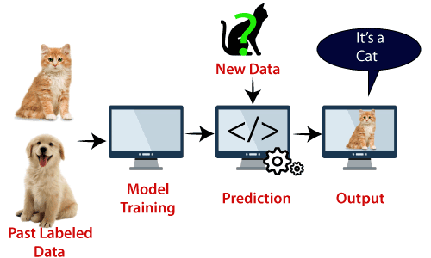
Example: SVM can be understood with the example that we have used in the KNN classifier. Suppose we see a strange cat that also has some features of dogs, so if we want a model that can accurately identify whether it is a cat or dog, so such a model can be created by using the SVM algorithm. We will first train our model with lots of images of cats and dogs so that it can learn about different features of cats and dogs, and then we test it with this strange creature. So as support vector creates a decision boundary between these two data (cat and dog) and choose extreme cases (support vectors), it will see the extreme case of cat and dog. On the basis of the support vectors, it will classify it as a cat.
SVM algorithm can be used for Face detection, image classification, text categorization, etc.

Slide 129
Types of SVM:
Linear SVM - Linear SVM is used for linearly separable data, which means if a dataset can be classified into two classes by using a single straight line, then such data is termed as linearly separable data, and classifier is used called as Linear SVM classifier.
Non-linear SVM - Non-Linear SVM is used for non-linearly separated data, which means if a dataset cannot be classified by using a straight line, then such data is termed as non-linear data and classifier used is called as Non-linear SVM classifier.

Slide 130
Hyperplane and Support Vectors in the SVM algorithm:
Hyperplane:
There can be multiple lines/decision boundaries to segregate the classes in n-dimensional space, but we need to find out the best decision boundary that helps to classify the data points. This best boundary is known as the hyperplane of SVM.
The dimensions of the hyperplane depend on the features present in the dataset, which means if there are 2 features (as shown in image), then hyperplane will be a straight line. And if there are 3 features, then hyperplane will be a 2-dimension plane.
We always create a hyperplane that has a maximum margin, which means the maximum distance between the data points.
Support Vectors:
The data points or vectors that are the closest to the hyperplane and which affect the position of the hyperplane are termed as Support Vector. Since these vectors support the hyperplane, hence called a Support vector.

Slide 131
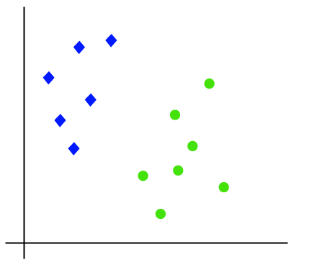

Linear SVM:
The working of the SVM algorithm can be understood by using an example. Suppose we have a dataset that has two tags (green and blue), and the dataset has two features x1 and x2. We want a classifier that can classify the pair(x1, x2) of coordinates in either green or blue. Consider the below image:
So as it is 2-d space so by just using a straight line, we can easily separate these two classes. But there can be multiple lines that can separate these classes.

Slide 132

Hence, the SVM algorithm helps to find the best line or decision boundary; this best boundary or region is called as a hyperplane.
SVM algorithm finds the closest point of the lines from both the classes. These points are called support vectors. The distance between the vectors and the hyperplane is called as margin. And the goal of SVM is to maximize this margin. The hyperplane with maximum margin is called the optimal hyperplane.

Slide 133

Non-Linear SVM:
If data is linearly arranged, then we can separate it by using a straight line, but for non-linear data, we cannot draw a single straight line. Consider the below image:
So to separate these data points, we need to add one more dimension. For linear data, we have used two dimensions x and y, so for non-linear data, we will add a third dimension z. It can be calculated as:
Z = x2 + y2

Slide 134

By adding the third dimension, the sample space will become as below image:

Slide 135

So now, SVM will divide the datasets into classes in the following way. Consider the below image:

Slide 136

Since we are in 3-d Space, hence it is looking like a plane parallel to the x-axis.
If we convert it in 2d space with z=1, then it will become as:
Hence we get a circumference of radius 1 in case of non-linear data.

Slide 137
Python Implementation of Support Vector Machine:
Now we will implement the SVM algorithm using Python. Here we will use the same dataset user_data, which we have used in Logistic regression and KNN classification.
Data Pre-processing step
Till the Data pre-processing step, the code will remain the same. Below is the code:
# importing libraries
import numpy as nm
import matplotlib.pyplot as mtp
import pandas as pd
#importing datasets
data_set= pd.read_csv('user_data.csv')
#Extracting Independent and dependent Variable
x= data_set.iloc[:, [2,3]].values
y= data_set.iloc[:, 4].values

Slide 138

# Splitting the dataset into training and test set.
from sklearn.model_selection import train_test_split
x_train, x_test, y_train, y_test= train_test_split(x, y, test_size= 0.25, random_state=0)
# feature Scaling
from sklearn.preprocessing import StandardScaler
st_x= StandardScaler()
x_train= st_x.fit_transform(x_train)
x_test= st_x.transform(x_test)

Slide 139

The scaled output for the test set will be:

Slide 140
Fitting the SVM classifier to the training set:
Now the training set will be fitted to the SVM classifier. To create the SVM classifier, we will import SVC class from Sklearn.svm library. Below is the code for it:
from sklearn.svm import SVC # "Support vector classifier"
classifier = SVC(kernel='linear', random_state=0)
classifier.fit(x_train, y_train)
In the above code, we have used kernel='linear', as here we are creating SVM for linearly separable data. However, we can change it for non-linear data. And then we fitted the classifier to the training dataset(x_train, y_train)
Output:
SVC(C=1.0, cache_size=200, class_weight=None, coef0=0.0,
decision_function_shape='ovr', degree=3, gamma='auto_deprecated',
kernel='linear', max_iter=-1, probability=False, random_state=0,
shrinking=True, tol=0.001, verbose=False)
The model performance can be altered by changing the value of C(Regularization factor), gamma, and kernel.

Slide 141

Predicting the test set result:
Now, we will predict the output for test set. For this, we will create a new vector y_pred. Below is the code for it:
# Predicting the test set result
y_pred= classifier.predict(x_test)
After getting the y_pred vector, we can compare the result of y_pred and y_test to check the difference between the actual value and predicted value.
Output:

Slide 142

Creating the confusion matrix: Now we will see the performance of the SVM classifier that how many incorrect predictions are there as compared to the Logistic regression classifier. To create the confusion matrix, we need to import the confusion_matrix function of the sklearn library. After importing the function, we will call it using a new variable cm. The function takes two parameters, mainly y_true( the actual values) and y_pred (the targeted value return by the classifier).
#Creating the Confusion matrix
from sklearn.metrics import confusion_matrix
cm= confusion_matrix(y_test, y_pred)
Output:
As we can see in the above output image, there are 66+24= 90 correct predictions and 8+2= 10 correct predictions. Therefore we can say that our SVM model improved as compared to the Logistic regression model.

Slide 143
Visualizing the training set result:
Now we will visualize the training set result, below is the code for it:
from matplotlib.colors import ListedColormap
x_set, y_set = x_train, y_train
x1, x2 = nm.meshgrid(nm.arange(start = x_set[:, 0].min() - 1, stop = x_set[:, 0].max() + 1, step =0.01),
nm.arange(start = x_set[:, 1].min() - 1, stop = x_set[:, 1].max() + 1, step = 0.01))
mtp.contourf(x1, x2, classifier.predict(nm.array([x1.ravel(), x2.ravel()]).T).reshape(x1.shape),
alpha = 0.75, cmap = ListedColormap(('red', 'green')))
mtp.xlim(x1.min(), x1.max())
mtp.ylim(x2.min(), x2.max())
for i, j in enumerate(nm.unique(y_set)):
mtp.scatter(x_set[y_set == j, 0], x_set[y_set == j, 1],
c = ListedColormap(('red', 'green'))(i), label = j)
mtp.title('SVM classifier (Training set)')
mtp.xlabel('Age')
mtp.ylabel('Estimated Salary')
mtp.legend()
mtp.show()

Slide 144

Output:
By executing the above code, we will get the output as:
As we can see, the above output is appearing similar to the Logistic regression output. In the output, we got the straight line as hyperplane because we have used a linear kernel in the classifier. And we have also discussed above that for the 2d space, the hyperplane in SVM is a straight line.

Slide 145
Visualizing the test set result:
from matplotlib.colors import ListedColormap
x_set, y_set = x_test, y_test
x1, x2 = nm.meshgrid(nm.arange(start = x_set[:, 0].min() - 1, stop = x_set[:, 0].max() + 1, step =0.01),
nm.arange(start = x_set[:, 1].min() - 1, stop = x_set[:, 1].max() + 1, step = 0.01))
mtp.contourf(x1, x2, classifier.predict(nm.array([x1.ravel(), x2.ravel()]).T).reshape(x1.shape),
alpha = 0.75, cmap = ListedColormap(('red','green' )))
mtp.xlim(x1.min(), x1.max())
mtp.ylim(x2.min(), x2.max())
for i, j in enumerate(nm.unique(y_set)):
mtp.scatter(x_set[y_set == j, 0], x_set[y_set == j, 1],
c = ListedColormap(('red', 'green'))(i), label = j)
mtp.title('SVM classifier (Test set)')
mtp.xlabel('Age')
mtp.ylabel('Estimated Salary')
mtp.legend()
mtp.show()

Slide 146

Output:
By executing the above code, we will get the output as:
As we can see in the above output image, the SVM classifier has divided the users into two regions (Purchased or Not purchased). Users who purchased the SUV are in the red region with the red scatter points. And users who did not purchase the SUV are in the green region with green scatter points. The hyperplane has divided the two classes into Purchased and not purchased variable.

Slide 147
Naïve Bayes Classifier Algorithm

Slide 148
Naïve Bayes Classifier Algorithm:
Naïve Bayes algorithm is a supervised learning algorithm, which is based on Bayes theorem and used for solving classification problems.
It is mainly used in text classification that includes a high-dimensional training dataset.
Naïve Bayes Classifier is one of the simple and most effective Classification algorithms which helps in building the fast machine learning models that can make quick predictions.
It is a probabilistic classifier, which means it predicts on the basis of the probability of an object.
Some popular examples of Naïve Bayes Algorithm are spam filtration, Sentimental analysis, and classifying articles.
Why is it called Naïve Bayes?
Naïve: It is called Naïve because it assumes that the occurrence of a certain feature is independent of the occurrence of other features. Such as if the fruit is identified on the bases of color, shape, and taste, then red, spherical, and sweet fruit is recognized as an apple. Hence each feature individually contributes to identify that it is an apple without depending on each other.
Bayes: It is called Bayes because it depends on the principle of Bayes' Theorem.

Slide 149

Bayes' Theorem:
Bayes' theorem is also known as Bayes' Rule or Bayes' law, which is used to determine the probability of a hypothesis with prior knowledge. It depends on the conditional probability.
The formula for Bayes' theorem is given as:
Where,
P(A|B) is Posterior probability: Probability of hypothesis A on the observed event B.
P(B|A) is Likelihood probability: Probability of the evidence given that the probability of a hypothesis is true.
P(A) is Prior Probability: Probability of hypothesis before observing the evidence.
P(B) is Marginal Probability: Probability of Evidence.

Slide 150
Working of Naïve Bayes' Classifier:
Working of Naïve Bayes' Classifier can be understood with the help of the below example:
Suppose we have a dataset of weather conditions and corresponding target variable "Play". So using this dataset we need to decide that whether we should play or not on a particular day according to the weather conditions. So to solve this problem,
we need to follow the below steps:
Convert the given dataset into frequency tables.
Generate Likelihood table by finding the probabilities of given features.
Now, use Bayes theorem to calculate the posterior probability.
Problem: If the weather is sunny, then the Player should play or not?
Solution: To solve this, first consider the below dataset:

Slide 151
 | OUTLOOK | PLAY
0 | Rainy | Yes
1 | Sunny | Yes
2 | Overcast | Yes
3 | Overcast | Yes
4 | Sunny | No
5 | Rainy | Yes
6 | Sunny | Yes
7 | Overcast | Yes
8 | Rainy | No
9 | Sunny | No
10 | Sunny | Yes
11 | Rainy | No
12 | Overcast | Yes
13 | Overcast | Yes

Slide 152
Frequency table for the Weather Conditions:
Weather | Yes | No
Overcast | 5 | 0
Rainy | 2 | 2
Sunny | 3 | 2
Total | 10 | 5
Likelihood table weather condition:
Weather | No | Yes
Overcast | 0 | 5 | 5/14= 0.35
Rainy | 2 | 2 | 4/14=0.29
Sunny | 2 | 3 | 5/14=0.35
All | 4/14=0.29 | 10/14=0.71

Slide 153
Applying Bayes'theorem:
P(Yes|Sunny)= P(Sunny|Yes)*P(Yes)/P(Sunny)
P(Sunny|Yes)= 3/10= 0.3
P(Sunny)= 0.35
P(Yes)=0.71
So P(Yes|Sunny) = 0.3*0.71/0.35= 0.60
P(No|Sunny)= P(Sunny|No)*P(No)/P(Sunny)
P(Sunny|NO)= 2/4=0.5
P(No)= 0.29
P(Sunny)= 0.35
So P(No|Sunny)= 0.5*0.29/0.35 = 0.41
So as we can see from the above calculation that P(Yes|Sunny)>P(No|Sunny)
Hence on a Sunny day, Player can play the game.

Slide 154
Advantages of Naïve Bayes Classifier:
Naïve Bayes is one of the fast and easy ML algorithms to predict a class of datasets.
It can be used for Binary as well as Multi-class Classifications.
It performs well in Multi-class predictions as compared to the other Algorithms.
It is the most popular choice for text classification problems.
Disadvantages of Naïve Bayes Classifier:
Naive Bayes assumes that all features are independent or unrelated, so it cannot learn the relationship between features.
Applications of Naïve Bayes Classifier:
It is used for Credit Scoring.
It is used in medical data classification.
It can be used in real-time predictions because Naïve Bayes Classifier is an eager learner.
It is used in Text classification such as Spam filtering and Sentiment analysis.

Slide 155
Types of Naïve Bayes Model:
Gaussian: The Gaussian model assumes that features follow a normal distribution. This means if predictors take continuous values instead of discrete, then the model assumes that these values are sampled from the Gaussian distribution.
Multinomial: The Multinomial Naïve Bayes classifier is used when the data is multinomial distributed. It is primarily used for document classification problems, it means a particular document belongs to which category such as Sports, Politics, education, etc. The classifier uses the frequency of words for the predictors.
Bernoulli: The Bernoulli classifier works similar to the Multinomial classifier, but the predictor variables are the independent Booleans variables. Such as if a particular word is present or not in a document. This model is also famous for document classification tasks.

Slide 156
Python Implementation of the Naïve Bayes algorithm:
Now we will implement a Naive Bayes Algorithm using Python. So for this, we will use the "user_data" dataset, which we have used in our other classification model. Therefore we can easily compare the Naive Bayes model with the other models.
Steps to implement:
Data Pre-processing step
Fitting Naive Bayes to the Training set
Predicting the test result
Test accuracy of the result(Creation of Confusion matrix)
Visualizing the test set result.

Slide 157
DATA PREPROCESSING STEPS:
In this step, we will pre-process/prepare the data so that we can use it efficiently in our code.
It is similar as we did in data-pre-processing.
# Importing the libraries
import numpy as nm
import matplotlib.pyplot as mtp
import pandas as pd
# Importing the dataset
dataset = pd.read_csv('user_data.csv')
x = dataset.iloc[:, [2, 3]].values
y = dataset.iloc[:, 4].values
# Splitting the dataset into the Training set and Test set
from sklearn.model_selection import train_test_split
x_train, x_test, y_train, y_test = train_test_split(x, y, test_size = 0.25, random_state = 0)

Slide 158
# Feature Scaling
from sklearn.preprocessing import StandardScaler
sc = StandardScaler()
x_train = sc.fit_transform(x_train)
x_test = sc.transform(x_test)
In the above code, we have loaded the dataset into our program using "dataset = pd.read_csv('user_data.csv’).
The loaded dataset is divided into training and test set, and then we have scaled the feature variable.

Slide 159

The output for the dataset is given as:

Slide 160
Fitting Naive Bayes to the Training Set:
After the pre-processing step, now we will fit the Naive Bayes model to the Training set. Below is the code for it:
# Fitting Naive Bayes to the Training set
from sklearn.naive_bayes import GaussianNB
classifier = GaussianNB()
classifier.fit(x_train, y_train)
In the above code, we have used the GaussianNB classifier to fit it to the training dataset.
We can also use other classifiers as per our requirement.
Output:
GaussianNB(priors=None, var_smoothing=1e-09)

Slide 161

Prediction of the test set result:
Now we will predict the test set result. For this, we will create a new predictor variable y_pred, and will use the predict function to make the predictions.
# Predicting the Test set results
y_pred = classifier.predict(x_test)
Output:
The above output shows the result for prediction vector y_pred and real vector y_test. We can see that some predications are different from the real values, which are the incorrect predictions.

Slide 162

Creating Confusion Matrix:
Now we will check the accuracy of the Naive Bayes classifier using the Confusion matrix. Below is the code for it:
# Making the Confusion Matrix
from sklearn.metrics import confusion_matrix
cm = confusion_matrix(y_test, y_pred)
Output:
As we can see in the above confusion matrix output, there are 7+3= 10 incorrect predictions, and 65+25=90 correct predictions.

Slide 163
Visualizing the training set result:
# Visualising the Training set results
from matplotlib.colors import ListedColormap
x_set, y_set = x_train, y_train
X1, X2 = nm.meshgrid(nm.arange(start = x_set[:, 0].min() - 1, stop = x_set[:, 0].max() + 1, step = 0.01),
nm.arange(start = x_set[:, 1].min() - 1, stop = x_set[:, 1].max() + 1, step = 0.01))
mtp.contourf(X1, X2, classifier.predict(nm.array([X1.ravel(), X2.ravel()]).T).reshape(X1.shape),
alpha = 0.75, cmap = ListedColormap(('purple', 'green')))
mtp.xlim(X1.min(), X1.max())
mtp.ylim(X2.min(), X2.max())
for i, j in enumerate(nm.unique(y_set)):
mtp.scatter(x_set[y_set == j, 0], x_set[y_set == j, 1],
c = ListedColormap(('purple', 'green'))(i), label = j)
mtp.title('Naive Bayes (Training set)')
mtp.xlabel('Age')
mtp.ylabel('Estimated Salary')
mtp.legend()
mtp.show()

Slide 164

Output:
In the above output we can see that the Naïve Bayes classifier has segregated the data points with the fine boundary. It is Gaussian curve as we have used GaussianNB classifier in our code.

Slide 165
Visualizing the Test set result:
# Visualising the Test set results
from matplotlib.colors import ListedColormap
x_set, y_set = x_test, y_test
X1, X2 = nm.meshgrid(nm.arange(start = x_set[:, 0].min() - 1, stop = x_set[:, 0].max() + 1, step = 0.01),
nm.arange(start = x_set[:, 1].min() - 1, stop = x_set[:, 1].max() + 1, step = 0.01))
mtp.contourf(X1, X2, classifier.predict(nm.array([X1.ravel(), X2.ravel()]).T).reshape(X1.shape),
alpha = 0.75, cmap = ListedColormap(('purple', 'green')))
mtp.xlim(X1.min(), X1.max())
mtp.ylim(X2.min(), X2.max())
for i, j in enumerate(nm.unique(y_set)):
mtp.scatter(x_set[y_set == j, 0], x_set[y_set == j, 1],
c = ListedColormap(('purple', 'green'))(i), label = j)
mtp.title('Naive Bayes (test set)')
mtp.xlabel('Age')
mtp.ylabel('Estimated Salary')
mtp.legend()
mtp.show()

Slide 166

Output:
The above output is final output for test set data. As we can see the classifier has created a Gaussian curve to divide the "purchased" and "not purchased" variables. There are some wrong predictions which we have calculated in Confusion matrix. But still it is pretty good classifier.

Slide 167
Decision Tree Classification Algorithm

Slide 168
Decision Tree Classification Algorithm
Decision Tree is a Supervised learning technique that can be used for both classification and Regression problems, but mostly it is preferred for solving Classification problems. It is a tree-structured classifier, where internal nodes represent the features of a dataset, branches represent the decision rules and each leaf node represents the outcome.
In a Decision tree, there are two nodes, which are the Decision Node and Leaf Node. Decision nodes are used to make any decision and have multiple branches, whereas Leaf nodes are the output of those decisions and do not contain any further branches.
The decisions or the test are performed on the basis of features of the given dataset.
It is a graphical representation for getting all the possible solutions to a problem/decision based on given conditions.
It is called a decision tree because, similar to a tree, it starts with the root node, which expands on further branches and constructs a tree-like structure.
In order to build a tree, we use the CART algorithm, which stands for Classification and Regression Tree algorithm.
A decision tree simply asks a question, and based on the answer (Yes/No), it further split the tree into subtrees.

Slide 169

Note: A decision tree can contain categorical data (YES/NO) as well as numeric data.

Slide 170
Why use Decision Trees?
There are various algorithms in Machine learning, so choosing the best algorithm for the given dataset and problem is the main point to remember while creating a machine learning model. Below are the two reasons for using the Decision tree:
Decision Trees usually mimic human thinking ability while making a decision, so it is easy to understand.
The logic behind the decision tree can be easily understood because it shows a tree-like structure.
Root Node: Root node is from where the decision tree starts. It represents the entire dataset, which further gets divided into two or more homogeneous sets.
Leaf Node: Leaf nodes are the final output node, and the tree cannot be segregated further after getting a leaf node.
Splitting: Splitting is the process of dividing the decision node/root node into sub-nodes according to the given conditions.
Branch/Sub Tree: A tree formed by splitting the tree.
Pruning: Pruning is the process of removing the unwanted branches from the tree.
Parent/Child node: The root node of the tree is called the parent node, and other nodes are called the child nodes.

Slide 171
How does the Decision Tree algorithm Work?
In a decision tree, for predicting the class of the given dataset, the algorithm starts from the root node of the tree. This algorithm compares the values of root attribute with the record (real dataset) attribute and, based on the comparison, follows the branch and jumps to the next node.
For the next node, the algorithm again compares the attribute value with the other sub-nodes and move further. It continues the process until it reaches the leaf node of the tree.
The complete process can be better understood using the below algorithm:
Step-1: Begin the tree with the root node, says S, which contains the complete dataset.
Step-2: Find the best attribute in the dataset using Attribute Selection Measure (ASM).
Step-3: Divide the S into subsets that contains possible values for the best attributes.
Step-4: Generate the decision tree node, which contains the best attribute.
Step-5: Recursively make new decision trees using the subsets of the dataset created in step -3. Continue this process until a stage is reached where you cannot further classify the nodes and called the final node as a leaf node.

Slide 172

Example: Suppose there is a candidate who has a job offer and wants to decide whether he should accept the offer or Not. So, to solve this problem, the decision tree starts with the root node (Salary attribute by ASM). The root node splits further into the next decision node (distance from the office) and one leaf node based on the corresponding labels. The next decision node further gets split into one decision node (Cab facility) and one leaf node. Finally, the decision node splits into two leaf nodes (Accepted offers and Declined offer).
Consider the below diagram:

Slide 173
While implementing a Decision tree, the main issue arises that how to select the best attribute for the root node and for sub-nodes. So, to solve such problems there is a technique which is called as Attribute selection measure or ASM. By this measurement, we can easily select the best attribute for the nodes of the tree.
Information Gain and Gini Index
1. Information Gain:
Information gain is the measurement of changes in entropy after the segmentation of a dataset based on an attribute.
It calculates how much information a feature provides us about a class.
According to the value of information gain, we split the node and build the decision tree.
A decision tree algorithm always tries to maximize the value of information gain, and a node/attribute having the highest information gain is split first. It can be calculated using the below formula:
Information Gain= Entropy(S)- [(Weighted Avg) *Entropy(each feature)
Entropy: Entropy is a metric to measure the impurity in a given attribute. It specifies randomness in data. Entropy can be calculated as:
Entropy(s)= -P(yes)log2 P(yes)- P(no) log2 P(no)
Where,
S= Total number of samples
P(yes)= probability of yes
P(no)= probability of no

Slide 174
2. Gini Index:
Gini index is a measure of impurity or purity used while creating a decision tree in the CART(Classification and Regression Tree) algorithm.
An attribute with the low Gini index should be preferred as compared to the high Gini index.
It only creates binary splits, and the CART algorithm uses the Gini index to create binary splits.
Gini index can be calculated using the below formula:
Gini Index= 1- ∑jPj2
Pruning: Getting an Optimal Decision tree
Pruning is a process of deleting the unnecessary nodes from a tree in order to get the optimal decision tree.
A too-large tree increases the risk of overfitting, and a small tree may not capture all the important features of the dataset. Therefore, a technique that decreases the size of the learning tree without reducing accuracy is known as Pruning. There are mainly two types of tree pruning technology used:
Cost Complexity Pruning
Reduced Error Pruning.

Slide 175
Advantages of the Decision Tree:
It is simple to understand as it follows the same process which a human follow while making any decision in real-life.
It can be very useful for solving decision-related problems.
It helps to think about all the possible outcomes for a problem.
There is less requirement of data cleaning compared to other algorithms.
Disadvantages of the Decision Tree:
The decision tree contains lots of layers, which makes it complex.
It may have an overfitting issue, which can be resolved using the Random Forest algorithm.
For more class labels, the computational complexity of the decision tree may increase.

Slide 176
Python Implementation of Decision Tree:
Now we will implement the Decision tree using Python. For this, we will use the dataset "user_data.csv," which we have used in previous classification models. By using the same dataset, we can compare the Decision tree classifier with other classification models such as KNN SVM, LogisticRegression, etc.
Steps will also remain the same, which are given below:
Data Pre-processing step
Fitting a Decision-Tree algorithm to the Training set
Predicting the test result
Test accuracy of the result(Creation of Confusion matrix)
Visualizing the test set result.

Slide 177
1. Data Pre-Processing Step:
# importing libraries
import numpy as nm
import matplotlib.pyplot as mtp
import pandas as pd
# importing datasets
data_set= pd.read_csv('user_data.csv')
# Extracting Independent and dependent Variable
x= data_set.iloc[:, [2,3]].values
y= data_set.iloc[:, 4].values
# Splitting the dataset into training and test set.
from sklearn.model_selection import train_test_split
x_train, x_test, y_train, y_test= train_test_split(x, y, test_size= 0.25, random_state=0)
# feature Scaling
from sklearn.preprocessing import StandardScaler
st_x= StandardScaler()
x_train= st_x.fit_transform(x_train)
x_test= st_x.transform(x_test)

Slide 178

we have pre-processed the data. Where we have loaded the dataset, which is given as:

Slide 179
2. Fitting a Decision-Tree algorithm to the Training set:
Now we will fit the model to the training set. For this, we will import the DecisionTreeClassifier class
from sklearn.tree library. Below is the code for it:
#Fitting Decision Tree classifier to the training set
From sklearn.tree import DecisionTreeClassifier
classifier= DecisionTreeClassifier(criterion='entropy', random_state=0)
classifier.fit(x_train, y_train)
In the above code, we have created a classifier object, in which we have passed two main parameters;
"criterion='entropy': Criterion is used to measure the quality of split, which is calculated by information gain given by entropy.
random_state=0": For generating the random states.

Slide 180
Output:
DecisionTreeClassifier(class_weight=None, criterion='entropy', max_depth=None,
max_features=None, max_leaf_nodes=None,
min_impurity_decrease=0.0, min_impurity_split=None,
min_samples_leaf=1, min_samples_split=2,
min_weight_fraction_leaf=0.0, presort=False, random_state=0, splitter='best')

Slide 181

3. Predicting the test result
Now we will predict the test set result. We will create a new prediction vector y_pred. Below is the code for it:
# Predicting the test set result
y_pred= classifier.predict(x_test)
Output:
In the below output image, the predicted output and real test output are given. We can clearly see that there are some values in the prediction vector, which are different from the real vector values. These are prediction errors.

Slide 182

4. Test accuracy of the result (Creation of Confusion matrix)
In the above output, we have seen that there were some incorrect predictions, so if we want to know the number of correct and incorrect predictions, we need to use the confusion matrix. Below is the code for it:
# Creating the Confusion matrix
from sklearn.metrics import confusion_matrix
cm= confusion_matrix(y_test, y_pred)
In the above output image, we can see the confusion matrix, which has 6+3= 9 incorrect predictions and62+29=91 correct predictions. Therefore, we can say that compared to other classification models, the Decision Tree classifier made a good prediction.

Slide 183
5. Visualizing the training set result:
Here we will visualize the training set result. To visualize the training set result we will plot a graph for the decision tree classifier. The classifier will predict yes or No for the users who have either Purchased or Not purchased the SUV car as we did in Logistic Regression. Below is the code for it:
#Visulaizing the trianing set result
from matplotlib.colors import ListedColormap
x_set, y_set = x_train, y_train
x1, x2 = nm.meshgrid(nm.arange(start = x_set[:, 0].min() - 1, stop = x_set[:, 0].max() + 1, step =0.01),
nm.arange(start = x_set[:, 1].min() - 1, stop = x_set[:, 1].max() + 1, step = 0.01))
mtp.contourf(x1, x2, classifier.predict(nm.array([x1.ravel(), x2.ravel()]).T).reshape(x1.shape),
alpha = 0.75, cmap = ListedColormap(('purple','green' )))
mtp.xlim(x1.min(), x1.max())
mtp.ylim(x2.min(), x2.max())
fori, j in enumerate(nm.unique(y_set)):
mtp.scatter(x_set[y_set == j, 0], x_set[y_set == j, 1],
c = ListedColormap(('purple', 'green'))(i), label = j)
mtp.title('Decision Tree Algorithm (Training set)')
mtp.xlabel('Age')
mtp.ylabel('Estimated Salary')
mtp.legend()
mtp.show()

Slide 184

Output:
The output is completely different from the rest classification models. It has both vertical and horizontal lines that are splitting the dataset according to the age and estimated salary variable.
As we can see, the tree is trying to capture each dataset, which is the case of overfitting.

Slide 185
6. Visualizing the test set result:
Visualization of test set result will be similar to the visualization of the training set except that the training set will be replaced with the test set.
#Visulaizing the test set result
from matplotlib.colors import ListedColormap
x_set, y_set = x_test, y_test
x1, x2 = nm.meshgrid(nm.arange(start = x_set[:, 0].min() - 1, stop = x_set[:, 0].max() + 1, step =0.01),
nm.arange(start = x_set[:, 1].min() - 1, stop = x_set[:, 1].max() + 1, step = 0.01))
mtp.contourf(x1, x2, classifier.predict(nm.array([x1.ravel(), x2.ravel()]).T).reshape(x1.shape),
alpha = 0.75, cmap = ListedColormap(('purple','green' )))
mtp.xlim(x1.min(), x1.max())
mtp.ylim(x2.min(), x2.max())
fori, j in enumerate(nm.unique(y_set)):
mtp.scatter(x_set[y_set == j, 0], x_set[y_set == j, 1],
c = ListedColormap(('purple', 'green'))(i), label = j)
mtp.title('Decision Tree Algorithm(Test set)')
mtp.xlabel('Age')
mtp.ylabel('Estimated Salary')
mtp.legend()
mtp.show()

Slide 186

Output :
As we can see in the image that there are some green data points within the purple region and vice versa. So, these are the incorrect predictions which we have discussed in the confusion matrix.

Slide 187
Random Forest Algorithm

Slide 188
Random Forest Algorithm:
Random Forest is a popular machine learning algorithm that belongs to the supervised learning technique. It can be used for both Classification and Regression problems in ML. It is based on the concept of ensemble learning, which is a process of combining multiple classifiers to solve a complex problem and to improve the performance of the model.
As the name suggests, "Random Forest is a classifier that contains a number of decision trees on various subsets of the given dataset and takes the average to improve the predictive accuracy of that dataset." Instead of relying on one decision tree, the random forest takes the prediction from each tree and based on the majority votes of predictions, and it predicts the final output.
The greater number of trees in the forest leads to higher accuracy and prevents the problem of overfitting.

Slide 189


Slide 190
Assumptions for Random Forest:
Since the random forest combines multiple trees to predict the class of the dataset, it is possible that some decision trees may predict the correct output, while others may not. But together, all the trees predict the correct output. Therefore, below are two assumptions for a better Random forest classifier:
There should be some actual values in the feature variable of the dataset so that the classifier can predict accurate results rather than a guessed result.
The predictions from each tree must have very low correlations.
Why use Random Forest?
Below are some points that explain why we should use the Random Forest algorithm:
<="" li="">It takes less training time as compared to other algorithms.
It predicts output with high accuracy, even for the large dataset it runs efficiently.
It can also maintain accuracy when a large proportion of data is missing.

Slide 191
How does Random Forest algorithm work?
Random Forest works in two-phase first is to create the random forest by combining N decision tree, and second is to make predictions for each tree created in the first phase.
The Working process can be explained in the below steps and diagram:
Step-1: Select random K data points from the training set.
Step-2: Build the decision trees associated with the selected data points (Subsets).
Step-3: Choose the number N for decision trees that you want to build.
Step-4: Repeat Step 1 & 2.
Step-5: For new data points, find the predictions of each decision tree, and assign the new data points to the category that wins the majority votes.

Slide 192

Example: Suppose there is a dataset that contains multiple fruit images. So, this dataset is given to the Random forest classifier. The dataset is divided into subsets and given to each decision tree. During the training phase, each decision tree produces a prediction result, and when a new data point occurs, then based on the majority of results, the Random Forest classifier predicts the final decision.
Consider the below image:

Slide 193
Applications of Random Forest:
There are mainly four sectors where Random forest mostly used:
Banking: Banking sector mostly uses this algorithm for the identification of loan risk.
Medicine: With the help of this algorithm, disease trends and risks of the disease can be identified.
Land Use: We can identify the areas of similar land use by this algorithm.
Marketing: Marketing trends can be identified using this algorithm.
Advantages of Random Forest:
Random Forest is capable of performing both Classification and Regression tasks.
It is capable of handling large datasets with high dimensionality.
It enhances the accuracy of the model and prevents the overfitting issue.
Disadvantages of Random Forest:
Although random forest can be used for both classification and regression tasks, it is not more suitable for Regression tasks.

Slide 194
Python Implementation of Random Forest Algorithm
Now we will implement the Random Forest Algorithm tree using Python. For this, we will use the same dataset "user_data.csv", which we have used in previous classification models. By using the same dataset, we can compare the Random Forest classifier with other classification models such as Decision tree Classifier, KNN, SVM, Logistic Regression, etc.
Implementation Steps are given below:
Data Pre-processing step
Fitting the Random forest algorithm to the Training set
Predicting the test result
Test accuracy of the result (Creation of Confusion matrix)
Visualizing the test set result.

Slide 195
Data Pre-Processing Step:
# importing libraries
import numpy as nm
import matplotlib.pyplot as mtp
import pandas as pd
# importing datasets
data_set= pd.read_csv('user_data.csv')
# Extracting Independent and dependent Variable
x= data_set.iloc[:, [2,3]].values
y= data_set.iloc[:, 4].values
# Splitting the dataset into training and test set.
from sklearn.model_selection import train_test_split
x_train, x_test, y_train, y_test= train_test_split(x, y, test_size= 0.25, random_state=0)
# feature Scaling
from sklearn.preprocessing import StandardScaler
st_x= StandardScaler()
x_train= st_x.fit_transform(x_train)
x_test= st_x.transform(x_test)

Slide 196

Output :

Slide 197
2. Fitting the Random Forest algorithm to the training set:
Now we will fit the Random forest algorithm to the training set. To fit it, we will import the RandomForestClassifier class from the sklearn.ensemble library. The code is given below:
#Fitting Decision Tree classifier to the training set
from sklearn.ensemble import RandomForestClassifier
classifier= RandomForestClassifier(n_estimators= 10, criterion="entropy")
classifier.fit(x_train, y_train)
n_estimators= The required number of trees in the Random Forest. The default value is 10. We can choose any number but need to take care of the overfitting issue.
criterion= It is a function to analyze the accuracy of the split. Here we have taken "entropy" for the information gain.
Output:
RandomForestClassifier(bootstrap=True, class_weight=None, criterion='entropy',
max_depth=None, max_features='auto', max_leaf_nodes=None,
min_impurity_decrease=0.0, min_impurity_split=None,
min_samples_leaf=1, min_samples_split=2,
min_weight_fraction_leaf=0.0, n_estimators=10,
n_jobs=None, oob_score=False, random_state=None,
verbose=0, warm_start=False)

Slide 198

3. Predicting the Test Set result :
Since our model is fitted to the training set, so now we can predict the test result. For prediction, we will create a new prediction vector y_pred. Below is the code for it:
#Predicting the test set result
y_pred= classifier.predict(x_test)
By checking the prediction vector and test set real vector, we can determine the incorrect predictions done by the classifier.

Slide 199

4. Creating the Confusion Matrix :
Now we will create the confusion matrix to determine the correct and incorrect predictions. Below is the code for it:
#Creating the Confusion matrix
from sklearn.metrics import confusion_matrix
cm= confusion_matrix(y_test, y_pred)
As we can see in the matrix, there are 4+4= 8 incorrect predictions and 64+28= 92 correct predictions.

Slide 200
5. Visualizing the training Set result:
Here we will visualize the training set result. To visualize the training set result we will plot a graph for the Random forest classifier. The classifier will predict yes or No for the users who have either Purchased or Not purchased the SUV car as we did in Logistic Regression.
from matplotlib.colors import ListedColormap
x_set, y_set = x_train, y_train
x1, x2 = nm.meshgrid(nm.arange(start = x_set[:, 0].min() - 1, stop = x_set[:, 0].max() + 1, step =0.01),
nm.arange(start = x_set[:, 1].min() - 1, stop = x_set[:, 1].max() + 1, step = 0.01))
mtp.contourf(x1, x2, classifier.predict(nm.array([x1.ravel(), x2.ravel()]).T).reshape(x1.shape),
alpha = 0.75, cmap = ListedColormap(('purple','green' )))
mtp.xlim(x1.min(), x1.max())
mtp.ylim(x2.min(), x2.max())
for i, j in enumerate(nm.unique(y_set)):
mtp.scatter(x_set[y_set == j, 0], x_set[y_set == j, 1],
c = ListedColormap(('purple', 'green'))(i), label = j)
mtp.title('Random Forest Algorithm (Training set)')
mtp.xlabel('Age')
mtp.ylabel('Estimated Salary')
mtp.legend()
mtp.show()

Slide 201

Output:
The image is the visualization result for the Random Forest classifier working with the training set result. It is very much similar to the Decision tree classifier. Each data point corresponds to each user of the user_data, and the purple and green regions are the prediction regions. The purple region is classified for the users who did not purchase the SUV car, and the green region is for the users who purchased the SUV. So, in the Random Forest classifier, we have taken 10 trees that have predicted Yes or NO for the Purchased variable. The classifier took the majority of the predictions and provided the result.

Slide 202
6. Visualizing the test set result:
#Visualizing the test set result
from matplotlib.colors import ListedColormap
x_set, y_set = x_test, y_test
x1, x2 = nm.meshgrid(nm.arange(start = x_set[:, 0].min() - 1, stop = x_set[:, 0].max() + 1, step =0.01),
nm.arange(start = x_set[:, 1].min() - 1, stop = x_set[:, 1].max() + 1, step = 0.01))
mtp.contourf(x1, x2, classifier.predict(nm.array([x1.ravel(), x2.ravel()]).T).reshape(x1.shape),
alpha = 0.75, cmap = ListedColormap(('purple','green' )))
mtp.xlim(x1.min(), x1.max())
mtp.ylim(x2.min(), x2.max())
for i, j in enumerate(nm.unique(y_set)):
mtp.scatter(x_set[y_set == j, 0], x_set[y_set == j, 1],
c = ListedColormap(('purple', 'green'))(i), label = j)
mtp.title('Random Forest Algorithm(Test set)')
mtp.xlabel('Age')
mtp.ylabel('Estimated Salary')
mtp.legend()
mtp.show()

Slide 203

Output:
The image is the visualization result for the test set. We can check that there is a minimum number of incorrect predictions (8) without the Overfitting issue. We will get different results by changing the number of trees in the classifier.

Slide 204
Performance Metrics in Machine Learning

Slide 205

Performance Metrics in Machine Learning :
Evaluating the performance of a Machine learning model is one of the important steps while building an effective ML model. To evaluate the performance or quality of the model, different metrics are used, and these metrics are known as performance metrics or evaluation metrics. These performance metrics help us understand how well our model has performed for the given data. In this way, we can improve the model's performance by tuning the hyper-parameters. Each ML model aims to generalize well on unseen/new data, and performance metrics help determine how well the model generalizes on the new dataset.

Slide 206
1. Performance Metrics for Classification
In a classification problem, the category or classes of data is identified based on training data. The model learns from the given dataset and then classifies the new data into classes or groups based on the training. It predicts class labels as the output, such as Yes or No, 0 or 1, Spam or Not Spam, etc. To evaluate the performance of a classification model, different metrics are used, and some of them are as follows:
Accuracy
Confusion Matrix
Precision
Recall
F-Score
AUC(Area Under the Curve)-ROC

Slide 207

1. Accuracy:
The accuracy metric is one of the simplest Classification metrics to implement, and it can be determined as the number of correct predictions to the total number of predictions.
It can be formulated as:
To implement an accuracy metric, we can compare ground truth and predicted values in a loop, or we can also use the scikit-learn module for this.
from sklearn.metrics import accuracy_score
Here, metrics is a class of sklearn.
Then we need to pass the ground truth and predicted values in the function to calculate the accuracy.
print(f'Accuracy Score is {accuracy_score(y_test,y_hat)}’)
Although it is simple to use and implement, it is suitable only for cases where an equal number of samples belong to each class.

Slide 208
When to Use Accuracy?
It is good to use the Accuracy metric when the target variable classes in data are approximately balanced. For example, if 60% of classes in a fruit image dataset are of Apple, 40% are Mango. In this case, if the model is asked to predict whether the image is of Apple or Mango, it will give a prediction with 97% of accuracy.
When not to use Accuracy?
It is recommended not to use the Accuracy measure when the target variable majorly belongs to one class. For example, Suppose there is a model for a disease prediction in which, out of 100 people, only five people have a disease, and 95 people don't have one. In this case, if our model predicts every person with no disease (which means a bad prediction), the Accuracy measure will be 95%, which is not correct.

Slide 209

2. Confusion Matrix :
A confusion matrix is a tabular representation of prediction outcomes of any binary classifier, which is used to describe the performance of the classification model on a set of test data when true values are known.
The confusion matrix is simple to implement, but the terminologies used in this matrix might be confusing for beginners.
A typical confusion matrix for a binary classifier looks like the below image(However, it can be extended to use for classifiers with more than two classes).

Slide 210
We can determine the following from the above matrix:
In the matrix, columns are for the prediction values, and rows specify the Actual values. Here Actual and prediction give two possible classes, Yes or No. So, if we are predicting the presence of a disease in a patient, the Prediction column with Yes means, Patient has the disease, and for NO, the Patient doesn't have the disease.
In this example, the total number of predictions are 165, out of which 110 time predicted yes, whereas 55 times predicted No.
However, in reality, 60 cases in which patients don't have the disease, whereas 105 cases in which patients have the disease.
In general, the table is divided into four terminologies, which are as follows:
True Positive(TP): In this case, the prediction outcome is true, and it is true in reality, also.
True Negative(TN): in this case, the prediction outcome is false, and it is false in reality, also.
False Positive(FP): In this case, prediction outcomes are true, but they are false in actuality.
False Negative(FN): In this case, predictions are false, and they are true in actuality.

Slide 211


3. Precision :
The precision metric is used to overcome the limitation of Accuracy. The precision determines the proportion of positive prediction that was actually correct. It can be calculated as the True Positive or predictions that are actually true to the total positive predictions (True Positive and False Positive).
4. Recall or Sensitivity :
It is also similar to the Precision metric; however, it aims to calculate the proportion of actual positive that was identified incorrectly. It can be calculated as True Positive or predictions that are actually true to the total number of positives, either correctly predicted as positive or incorrectly predicted as negative (true Positive and false negative).
The formula for calculating Recall is given below:

Slide 212
When to use Precision and Recall?
From the above definitions of Precision and Recall, we can say that recall determines the performance of a classifier with respect to a false negative, whereas precision gives information about the performance of a classifier with respect to a false positive.
So, if we want to minimize the false negative, then, Recall should be as near to 100%, and if we want to minimize the false positive, then precision should be close to 100% as possible.
In simple words, if we maximize precision, it will minimize the FP errors, and if we maximize recall, it will minimize the FN error.

Slide 213

5. F-Scores :
F-score or F1 Score is a metric to evaluate a binary classification model on the basis of predictions that are made for the positive class. It is calculated with the help of Precision and Recall. It is a type of single score that represents both Precision and Recall. So, the F1 Score can be calculated as the harmonic mean of both precision and Recall, assigning equal weight to each of them.
The formula for calculating the F1 score is given below:
When to use F-Score?
As F-score make use of both precision and recall, so it should be used if both of them are important for evaluation, but one (precision or recall) is slightly more important to consider than the other. For example, when False negatives are comparatively more important than false positives, or vice versa.

Slide 214

6. AUC-ROC :
Sometimes we need to visualize the performance of the classification model on charts; then, we can use the AUC-ROC curve. It is one of the popular and important metrics for evaluating the performance of the classification model.
Firstly, let's understand ROC (Receiver Operating Characteristic curve) curve. ROC represents a graph to show the performance of a classification model at different threshold levels. The curve is plotted between two parameters, which are:
True Positive Rate
False Positive Rate
TPR or true Positive rate is a synonym for Recall, hence can be calculated as:

Slide 215

FPR or False Positive Rate can be calculated as:
To calculate value at any point in a ROC curve, we can evaluate a logistic regression model multiple times with different classification thresholds, but this would not be much efficient. So, for this, one efficient method is used, which is known as AUC.

Slide 216

AUC: Area Under the ROC curve:
AUC is known for Area Under the ROC curve.
As its name suggests, AUC calculates the two-dimensional area under the entire ROC curve, as shown below image:
AUC calculates the performance across all the thresholds and provides an aggregate measure. The value of AUC ranges from 0 to 1. It means a model with 100% wrong prediction will have an AUC of 0.0, whereas models with 100% correct predictions will have an AUC of 1.0.

Slide 217
When to Use AUC :
AUC should be used to measure how well the predictions are ranked rather than their absolute values. Moreover, it measures the quality of predictions of the model without considering the classification threshold.
When not to use AUC :
As AUC is scale-invariant, which is not always desirable, and we need calibrating probability outputs, then AUC is not preferable.
Further, AUC is not a useful metric when there are wide disparities in the cost of false negatives vs. false positives, and it is difficult to minimize one type of classification error.

Slide 218
2. Performance Metrics for Regression :
Regression is a supervised learning technique that aims to find the relationships between the dependent and independent variables. A predictive regression model predicts a numeric or discrete value. The metrics used for regression are different from the classification metrics. It means we cannot use the Accuracy metric (explained above) to evaluate a regression model; instead, the performance of a Regression model is reported as errors in the prediction. Following are the popular metrics that are used to evaluate the performance of Regression models.
Mean Absolute Error
Mean Squared Error
R2 Score
Adjusted R2

Slide 219

Mean Absolute Error (MAE) :
Mean Absolute Error or MAE is one of the simplest metrics, which measures the absolute difference between actual and predicted values, where absolute means taking a number as Positive.
To understand MAE, let's take an example of Linear Regression, where the model draws a best fit line between dependent and independent variables. To measure the MAE or error in prediction, we need to calculate the difference between actual values and predicted values. But in order to find the absolute error for the complete dataset, we need to find the mean absolute of the complete dataset.
The below formula is used to calculate MAE:
Here,
Y is the Actual outcome, Y' is the predicted outcome, and N is the total number of data points.
MAE is much more robust for the outliers. One of the limitations of MAE is that it is not differentiable, so for this, we need to apply different optimizers such as Gradient Descent. However, to overcome this limitation, another metric can be used, which is Mean Squared Error or MSE.

Slide 220

2. Mean Squared Error :
Mean Squared error or MSE is one of the most suitable metrics for Regression evaluation. It measures the average of the Squared difference between predicted values and the actual value given by the model.
Since in MSE, errors are squared, therefore it only assumes non-negative values, and it is usually positive and non-zero.
Moreover, due to squared differences, it penalizes small errors also, and hence it leads to over-estimation of how bad the model is.
MSE is a much-preferred metric compared to other regression metrics as it is differentiable and hence optimized better.
The formula for calculating MSE is given below:
Here, Y is the Actual outcome, Y' is the predicted outcome, and N is the total number of data points.

Slide 221

3. R Squared Score :
R squared error is also known as Coefficient of Determination, which is another popular metric used for Regression model evaluation. The R-squared metric enables us to compare our model with a constant baseline to determine the performance of the model. To select the constant baseline, we need to take the mean of the data and draw the line at the mean.
The R squared score will always be less than or equal to 1 without concerning if the values are too large or small.

Slide 222

4. Adjusted R Squared :
Adjusted R squared, as the name suggests, is the improved version of R squared error. R square has a limitation of improvement of a score on increasing the terms, even though the model is not improving, and it may mislead the data scientists.
To overcome the issue of R square, adjusted R squared is used, which will always show a lower value than R². It is because it adjusts the values of increasing predictors and only shows improvement if there is a real improvement.
We can calculate the adjusted R squared as follows:
Here,
n is the number of observations
k denotes the number of independent variables
and R_{a}² denotes the adjusted R²

Slide 223
THE END

